Slide 1
The program of workshops for teachers
Erasmus+ project „I am OK, you are OK”
Project goal: raising awareness of bullying and cyberbullying prevention processes among primary school employees. and educators outside
of school
Website: https://weareok.pl/

Slide 2
Materials were developed by:
Fundacja Edumocni, Polska https://edumocni.pl/
Justyna Kołodziej – Kozub https://www.facebook.com/profile.php?id=100059272547940
Bluebook srl, Włochy https://www.bluebook.it/
Monica Pomero, Letizia Zucchelli
Funded by the European Union. Views and opinions expressed are however those of the author(s) only and do not necessarily reflect those of the European Union or the European Education and Culture Executive Agency (EACEA). Neither the European Union nor EACEA can be held responsible for them.
Attribution 4.0 International (CC BY 4.0)

Slide 3
Psycho-educational workshop for teachers

Slide 4
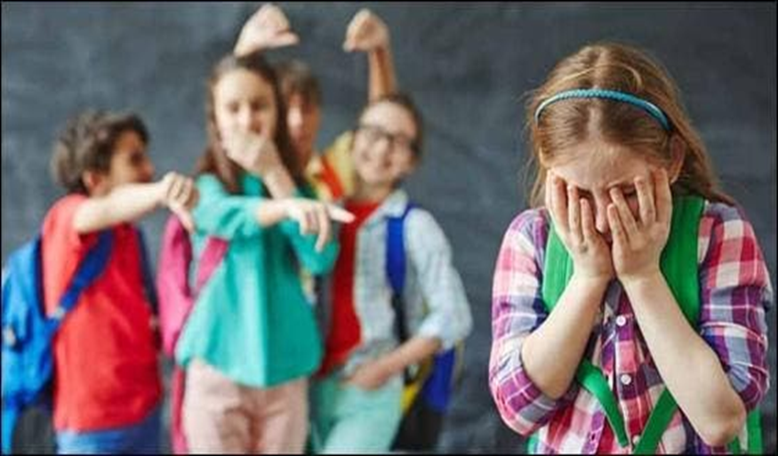
Where did the idea for the project come from?
Where did the idea for the project come from?
The analysis of trends in the countries participating in the study of the phenomenon of bullying between 1993/1994 to 2005/2006 shows that there was no change in the reduction of the phenomenon in Poland, yet the scale of the problem in other countries, e.g. in Italy, decreased
More and more often, parents report this problem at my workshops/consultations.

Slide 5
Bullying in primary schools (2018)

Slide 6
Based on examples of effective anti-bullying activities in the world, we analyzed the most effective programs. We exchanged experiences, good practices in the use of effective methods of dealing with peer violence in Italy, where bullying/violence rates at school were reduced by over 15 percentage points over 12 years.
On this basis we created a comprehensive model of preventing bullying in the form of a prospectus of workshops for school staff, parents and students.

Slide 7
The objective of the project
Reduction of bullying in primary schools in Poland - by raising the awareness of teachers, parents and students about the symptoms and long-term consequences of bullying among students. It can be done by increasing their social skills, i.e. assertiveness and empathy, the high level of which minimizes the occurrence of bullying among young people

Slide 8
What has worked for others?
The analysis of data from effective anti-bullying programs shows that it is important to create a favorable, student-friendly atmosphere in the classroom, which will facilitate the development of positive features of social coexistence, preventing the formation of excluded groups and ensure a sense of security for young people in the class.

Slide 9
• A tool supporting teachers and parents in building such a climate in the classroom and at home is the international method of Positive Discipline (according to the results of the UNESCO report from 2019), which strengthens the mutual bond between adults and young people. It also builds a relationship based on trust and mutual respect, which is key in bullying prevention, reduction of negative phenomena and encouraging young people to cooperate with adults.

Slide 10
Using Positive Discipline method by teachers and parents brings positive effects in building important social competences (cooperation, empathy, assertiveness, effective communication, independence, self-discipline) in young people, thus preventing the phenomenon of peer violence

Slide 11
The objective of the workshops for teachers
Equipping Teachers with Positive Discipline tools and techniques in order to improve student-teacher and student-student relationships, to build a positive atmosphere in the classroom and to create a culture of respect, tolerance and acceptance of the differences of each person.
Increased awareness in the area of peer violence recognition (bullying), reacting and effectively preventing the phenomenon by creating appropriate attitudes in the classroom.

Slide 12
The teacher is….?
An educator, sometimes a therapist, a mediator, a nurse, a police officer, an animator of games and activities, an organizer and tour guide, a nutritionist, an accountant and a secretary.
Anybody else?☺

Slide 13
What is the biggest challenge in the work of a teacher?

Slide 14
What do you like about your profession?

Slide 15
Why doesn’t being strict do the job?
Consequences of strict upbringing:
(shouting, obsessive control, putting the person down, making them feel guilty, physical and psychological punishment, comparing to others)
low self-esteem.
feeling of guilt.
Sensation of not being good enough.
Self-destructive behavior.
Low self awareness (I don’t know who I am, what I want, what is good for me)
Excessive rebellious attitude
Excessive submissive attitude
Withdrawal, fear, distrust

Slide 16
Why doesn’t overindulgence do the job??
Consequences of over-indulgent upbringing:
(lack of boundaries and limits, being overprotective, fulfilling whims not needs)
Low self control of emotions
Inadequate self esteem
“The I deserve” attitude
Feeling of helplessness
“The Peter Pan” syndrome
Higher tendency to become addicted
Difficulty in playing by the rules

Slide 17
Positive discipline
The consequences of democratic (authoritative) upbringing
(relationship, setting boundaries while respecting the needs of a child, explaining your decisions, assertiveness and kindness at the same time, giving choice, learning from mistakes, no punishments)
Adequate self esteem
Good social skills
Feeling of independence and decisiveness
Self awareness (I know what I want, who I am and what my strengths and weaknesses are)
Assertiveness in relationship with others
Responsibility and the will to develop

Slide 18
Basic PD tools
The message is firm and kind at the same time
Limited choice
Making (writing) contracts
Creating plans
"Decide what you will do"
Questions instead of commands
Focus on the solution
Natural consequences
Logical consequences

Slide 19
Why do CHILDREN misbehave?
1) What are the causes of bad behavior?
2) What does the student want to achieve with the misbehavior? – the motives of bad behavior
3) What encourages bad behavior? i.e. circumstances conducive to bad behavior

Slide 20
CHILD behavior is just the tip of the iceberg
THE NEED FOR BELONGING AND BEING VALUEABLE

Slide 21
Causes of bad behavior
Difficult family situation (divorce, parental addiction, single parenthood, family financial problems, attention deficit at home, death of a loved one, etc.)
Low level of school achievements, a student who has difficulties with appearing in the class forum due to his school results may want to appear in a different role - e.g. bully, class clown
Very strict upbringing at home, full of prohibitions, a lot of control, punishment, sometimes violence - the child cannot cope with emotions that are not allowed at home and therefore reacts at school

Slide 22
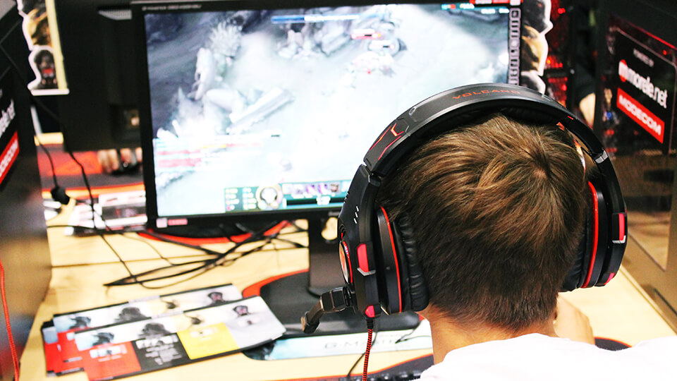
The Mills theory
The motive for inappropriate behavior of children is also a strong stimulation of the brain with stimuli provided by: television, computer games, online videos, (generally screens).
When a child comes to school in such a state, he perceives it as a stimuli desert of, boredom...
Something needs to be done with this desert, so the child, breaking the applicable rules, defying the teachers, receives the necessary thrill and adrenaline

Slide 23
The 4 wrong goals (motives) of behavior
according to the Dreikurs theory
drawing excessive attention to yourself - the belief that you are important when you are the center of attention
gaining power (authority) - it is the belief that only those who are strong command, deserve recognition
revenge, the criteria of belonging to a group is to repay with the same coin for the wrongs suffered, I am hurt so I can hurt others
lack of self-confidence - it's proving to others that you're not worth much, therefore you don't try

Slide 24
EXCESSIVE ATTENTION
The need for EXCESSIVE ATTENTION comes from the belief that "I only belong when I'm the center of attention"

Slide 25
ATTENTION - what to do?
Involve your child in some activity
Give non-verbal signals
Make him your assistant
For example: Ania, please watch the time and let me know when it’s 13.10

Slide 26
POWER (AUTHORITY)
The child wants to belong, to be needed, but does not know how to achieve it. The only thing that comes to a child’s mind is to resist. If we give him limited power, space, then he will be able to use this power in a constructive way. We do not aim to take away the power of the child, but to give him a choice that is limited and acceptable to us..

Slide 27
POWER (AUTHORITY)
The more someone tries to rule us, the more we resist.
That's why it's so important to get out of this misguided purpose of power in order to do something constructive.
Imagine you are clenching your fist and I am saying to you, "You know, I can't make you do anything. You will do what you decide. I just care and you would help me a lot if you opened that fist."
Would you like to open it? What happens then? I recognized you as decision makers…

Slide 28
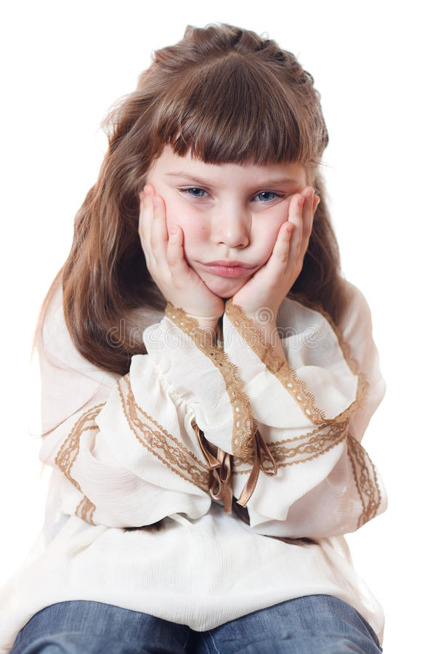
REVENGE
The child feels terrible and therefore makes us adults feel the same way. A strong need for revenge is activated
RECOGNIZE MY FEELINGS, I feel very bad inside

Slide 29
Revenge - what to do?
What our intuition tells us culturally is to disagree with such treatment. We think, "He's undermining my authority." We react to the tip of the iceberg (behaviour) by punishing the child. So we're only referring to behavior.
What happens then? We deepen the feeling of being unimportant and misunderstood.
The child begins to behave even worse. We are entering a vicious circle of revenge. The more we punish, the more intensive the revenge cycle.

Slide 30
Revenge
"You must feel terrible to be acting like this."
We notice a person with his/her emotions, not with behavior. We separate the child from his/her behavior
“Hearing what you say…I suspect you feel bad and I'm sorry about that. What would help you feel better about a decision I won't change?"
"At the same time, I don't approve of such comments because they are disrespectful."

Slide 31
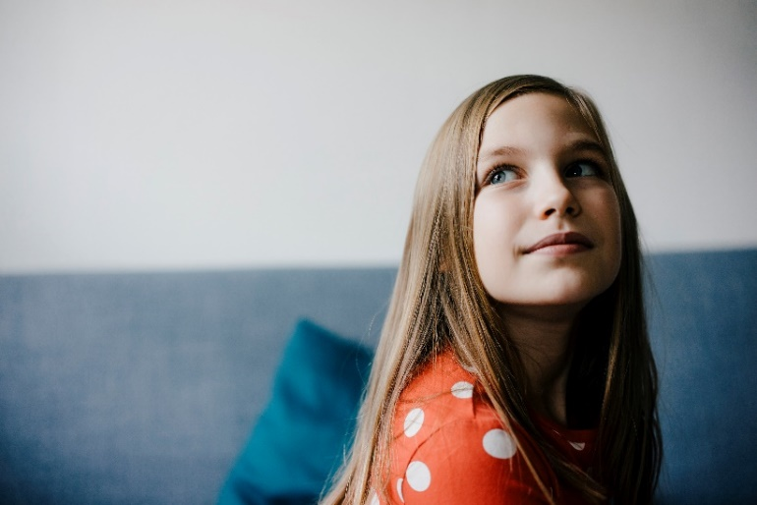
LACK OF FAITH
Show that you believe he can
Break the task down into small steps
-taking out notebooks, reviewing tasks to be done, choosing where to start doing homework, reading instructions, writing answers.

Slide 32
Lack of faith - what to do?
We can say: "Don't do homework for now, just take out your notebooks and mark with post-it-notes what is assigned. It will take you 2 minutes."
With such words, we encourage the kid to work and reduce the feeling of difficulty of completing a given task.
“Remember how we learned the multiplication table in grade 3? It seemed difficult at first too.” "Everything is hard before it becomes easy."

Slide 33
How to expose a CHILD's misguided purpose in the classroom?
Simon, do YOU know why you are behaving this way NOW?
Perhaps you are walking around the classroom to attract my attention?
Or maybe you want to show me that you can do whatever you want?
Or do you feel hurt and want to get back at me?
Or maybe you walk around the classroom because you think you can't do it anyway so you don't even try?

Slide 34
Circumstances that favor bad behavior
Fatigue - if our lesson is the 6th lesson of the day for the student, it will be harder for him to pay attention, he may be tempted to find some way to energize himself and the class.
Hunger is a strong biological stressor
Bullying

Slide 35
PUNISHMENT versus logical CONSEQUENCES
Punishment
Consequence
Objective: to make the child pay for undesirable behavior
It is unrelated to the offense
Disrespectful
It encourages rebellion, lying, or blind obedience
It weakens the relationship with the adult
It lowers self-esteem
It is ineffective in the long term
Objective: The child is to learn from the mistake made
It is directly connected with the offense
Full of respect for the child
It encourages you to look for solutions and learn from mistakes
It strengthens the relationship with the adult
It strengthens self-esteem
Effective in the long term

Slide 36
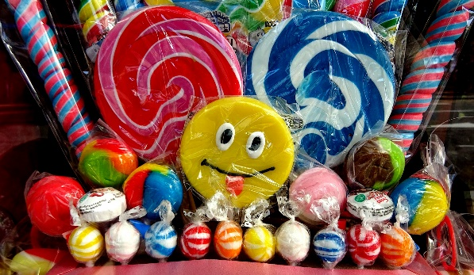
PRAISE versus ENCOURAGEMENT
Praise is like sweets:
Encouragement is like a nutritious meal
It refers to the doer “good girl"
Evaluative ("nice..")
What will others think... Is it pretty ma'am?
Emphasizes the end result ("you did it perfectly")
Refers to the action itself - "good job"
Appreciative ("I appreciate…")
What do I think about it.. Do you like it?
Emphasizes commitment and process " I can see how hard you tried..."
To zdjęcie, autor: Nieznany autor, licencja: CC BY

Slide 37
Temperament
TEMPERAMENT is an important element of our personality, our nature, unchanged throughout life
(speed and intensity of reaction, mobility, high and low energy, greater or less susceptibility to fatigue, high or low resistance to stress, low or high sensitivity)

Slide 38
Temperament
Types of temperament:
Sanguine
Choleric
Phlegmatic
Melancholic

Slide 39
The sanguine
An optimist, can attract people to himself, open and spontaneous, has a great sense of humor. He has a lot of energy
Talkative, curious. He lives for today. He is the soul of the party, easily makes friends
He doesn't get angry, he likes to be the center of attention and apologizes quickly.
He searches for everything, loses, often forgets
Has a “Flash in a pan mentality”

Slide 40
The energetic choleric
A person of action, focused on doing and directing others, a natural born boss, leader of the herd,
Inspires trust and respect among people
A good organizer
Is able to distribute tasks and organize work to others
Impatient and often speaks before thinking
Explosive ;)

Slide 41
Phlegmatic
Observer
Calm, poised and patient, quiet and at the same time cheerful
Reluctant to share the emotions he hides deeply.
Kind, polite, friendly
He can sympathize and care.
Can listen!
Slow, has less energy.
Radiates calm

Slide 42
Melancholic
Thinker and pessimist
Sensitive to beauty, musical.
Dreamer
Characterized by conscientiousness, great sensitivity to the needs of others and a tendency to sacrifice himself.
He chooses his friends carefully, he is distrustful
Prefers to remain in the shadows, so he will avoid speaking in front of the group
Persistent and precise, orderly organized, he always has to finish what he started, if he promises something - he keeps his word

Slide 43
SOFT skills that minimize violent behavior among children and adolescents

Slide 44
ASSERTIVENESS
having own opinion and the ability to express it, even if it differs from the opinion of others
the ability to say no without hurting others
the ability to set boundaries for other people without offending them
the ability to express one's emotions without hurting others
"I don't like the way you talk about Tom, we don't know the real reasons why he behaved like that. Let's not judge him!"

Slide 45
EMPATHY
The ability to recognize other people's emotions
The ability to empathize with another person
It allows us to feel like another person for a moment, to understand what he is feeling

Slide 46
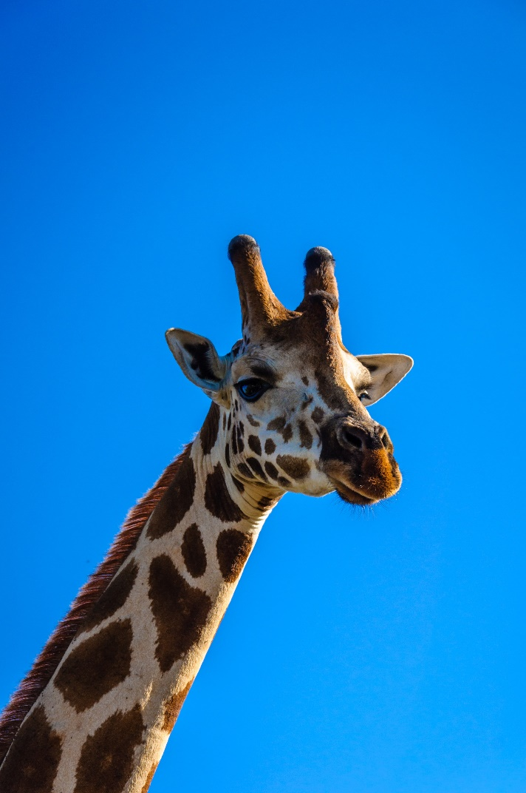
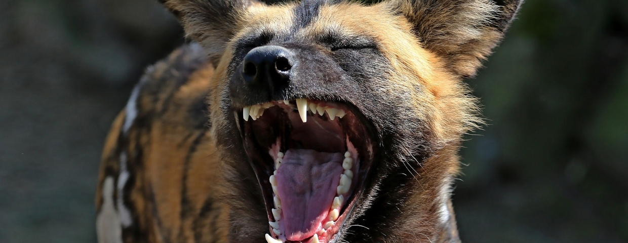
EFFECTIVE COMMUNICATION Non-Violent Communication (NVC)
The language of the giraffe versus the language of the jackal

Slide 47
The language of the Jackal: The YOU message
Stop talking!
You never listen to me!
Your problem. You're lazy so you got a bad grade!
Why can't you behave like others?
I can't talk to you normally!
You are oversensitive! Don't be hysterical!
Don't feel sorry for yourself, others have it worse than you!
WHAT DO THEY CONTAIN?

Slide 48
The language of the Giraffe: the I message
it only says something about me, about how I feel about the other person's behavior
"I'm sorry that you don't call me back"
INSTEAD OF
You'll never call me back! You do not care about me!

Slide 49
The language of the Giraffe: the I message
It bothers me that you interrupt me again.
I feel ignored when you text while talking to me
It's hard for me to hear that I'm oversensitive. My feelings are being judged, it doesn't help
You have no permission to talk to me that way
I need YOU to help me this time
CZEGO NIE ZAWIERAJĄ?

Slide 50
The ADVANTAGES of "the giraffe language"
it does not judge the other person,
is concrete, based on facts,
it is personal, so it increases the level of openness in the relationship
The YOU message: "You are selfish. As usual, you're not listening to me!"
The I message: "I feel ignored when you look at your phone when I'm talking to you"

Slide 51
Find the “I message" (in the following):
I don't like it when you're late for class.
Stop feeling sorry for yourself and start learning.
It bothers me that you're talking now while I’m teaching
You're a latecomer like no other!
It's your fault! Because of you I didn't manage to finish the test
You're lazy, you always keep putting things off until later
I can't concentrate in this noise
It's hard for me to teach when you're talking
I feel angry when you talk to me like this

Slide 52
Replace the “YOU message” with the “I message”
"You always interrupt me when I'm talking"
……….
"You never listen to what I say"
…………
"You keep taking my charger without permission"
…………
"You're so disorganized! How could you lose the keys?"
………..

Slide 53
The 4-step model of Nonviolent Communication
1. Expressing feelings:
I feel / I don't like / I am / it disturbs me (when)………
2. Description of the facts which we refer to - without judgment.
When you …. (description of facts)
3. Expressing your needs:
Because I need…..
4. Expressing your expectations - that is, asking for specific behavior in the future:
I expect that next time ...

Slide 54
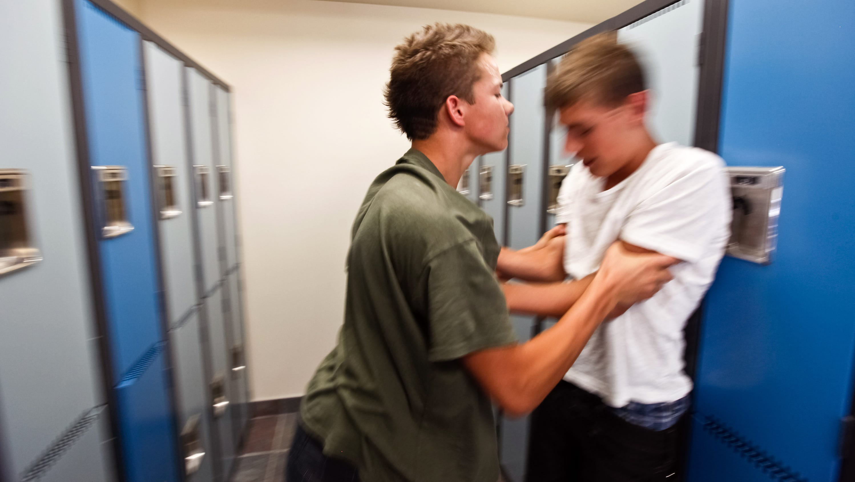
The ability to solve conflicts

Slide 55
Situation ☺
During the break after PE, the 11-year-old Stan pushes Tom, who falls to the floor.
The context:
(During Physical Education lesson, when the boys were choosing members of their football teams - Tom said to Stan: "I don't want you on the team because you're a loser!")
How does the teacher deal with this?

Slide 56
Mistakes made by adults during children's conflicts:
Investigating, who started it? Determining who is guilty.
Taking the side of the child who is crying
Generalizing - you always….
Judging.
Threatening
Showing pity
Giving a ready solution, e.g. "apologize and avoid each other"

Slide 57
Let them hear each other out. Help to find the needs behind the their behavior
Stan, Tom - I want to talk to you, because I see that something is going on between you two. I would like to help you find a solution to this situation because I have the impression that it is difficult for you.
Stan, were you upset with Tom because he said something unpleasant when setting teams...? Right?
Tom, I can see that you are also nervous because you wanted to talk and not to fight right away, right?"

Slide 58
What is worth doing in the case of children's conflict?
Question: What happened that made you react like that? – to get to know both perspectives, to determine who suffered.
Questions full of curiosity: How do you feel about it now?, how does your friend feel, what do you think? What does this situation teach you?
Searching for a solution. What ideas do you have for resolving this conflict/repairing the harm?
A lesson for the future. What do you need to do next time in a similar situation so that it doesn't happen again?
IMPORTANT
Impartiality
Active listening
Paraphrasing
Encouraging kids to look for solutions
Being a mediator, not a judge!

Slide 59
What is BULLYING?
It is regular, long-term exposure to harmful actions by other students, the purpose of which is to cause him/her psychological pain (humiliation, causing distress and a sense of rejection)

Slide 60
3 FEATURES OF BULLYING
3 FEATURES OF BULLYING
Intentionality
Action intended to cause harm
Not always present at the early stage
Repetition
Refers to “smaller” acts committed over a longer period of time
in the case of relational violence, it relies on persistence
Imbalance of power
the victim becomes helpless and stops defending himself/herself
it may be due to physical superiority however it often results from other factors

Slide 61
TYPES OF BULLYING
Physical:
hitting, spitting, pulling, pushing
destruction or theft of another student’s belongings such as clothes, notebooks, phone.
Verbal:
Calling names, making fun of, insulting or vulgar remarks
Gossiping about the person
Cyber violence:
Sending out insulting texts by smart phone or internet
Sending out compromising photos of the victim
Attacks on online forums
Relational
Exclusion from common activities
Not communicating/ ignoring the victim
Manipulating others so that they alienate the victim

Slide 62
SAD FACTS
90% of young people in schools think violence is wrong, but only 17% react when they witness violence. fear of exclusion, lack of acceptance of the peer group wins over the reaction to violence at school. Students very rarely tell teachers and parents about the bullying they experience because they believe that teachers can do little or nothing about it and that the parents' reaction can make it worse, so they suffer alone.

Slide 63
Which is NOT bullying?
An argument or fight that happens once in a while after which everything goes back to normal
Unpleasant verbal exchange between friendly children followed by reaching agreement
A dispute or a break-up

Slide 64
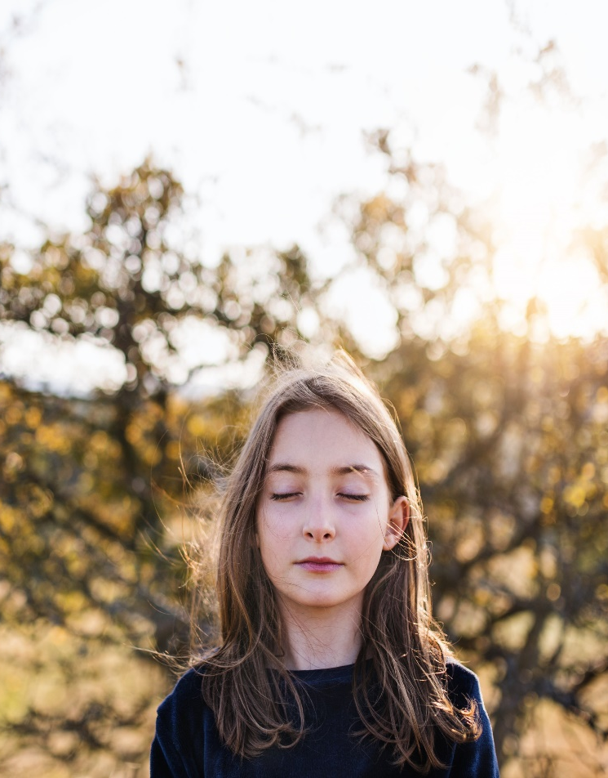
SYMPTOMS of experiencing violence. What should be worrying?
Sadness, crying, self-isolation, avoiding contact with others
Indifference, resignation from interests
Constant fatigue and lack of energy, drowsiness
Critical thinking about oneself
Talking about death
Tantrums, aggression, self-aggression (mutilations)
Fears limiting daily functioning
Suppressed appetite or binge eating
Psychosomatic complaints: e.g. headaches, shortness of breath, abdominal pain
Difficulties with concentration, memory, deterioration of grades

Slide 65
How to help a child experiencing peer violence?
Reassure the child that it's not his fault
You can remind the child that many people have also experienced peer violence. Being a victim of bullying is not a sign of weakness, and showing violence is also not a sign of strength.

Slide 66
WHY DO SOME CHILDREN HURT OTHERS?
People naturally gather in groups based on similarities and move away from dissimilar groups. Therefore, it is important to teach the child respect, tolerance, acceptance of others.
They feel unhappy and take out their sadness, anger and grief on others.
They experience violence at home and take it out on the weaker ones at school
They have low level of empathy and self-esteem and they do everything they can to prevent others from noticing it

Slide 67
The effects of bullying
social anxiety
depression
suicidal thoughts – there is a term called bully-cide (suicide resulting from bulling)
lower self-esteem
psychosomatic disorders such as insomnia, bedwetting and inhibited appetite

Slide 68
The effects of bullying
Severe feelings of humiliation, fear, despair and sadness, a sense of loneliness, low self-esteem, powerlessness or helplessness.
At the same time, victims may feel great anger, grief and hatred towards the perpetrators, but also towards the witnesses who did not react and did not help.
Experiencing such emotions has a negative impact on concentration and, as a result, on academic performance. Victims usually think negatively about themselves, e.g.: “I am useless”, “I am different”, “something is wrong with me”.

Slide 69
How to talk to the bully?
Bullying is bad behavior, which means that it must be stopped, but it does not mean that a child who behaves in this way is a bad person.
It is worth separating the child from his behavior so that he maintains his self-esteem
It is much more effective to make it easier for the child to understand that their behavior is unacceptable and to explain its impact on others

Slide 70
What to do when we notice BULLYING?
The main method of dealing with a bullying situation should be INTERVENTION, consisting primarily in stopping the person using violence from using it, protecting the person who is being hurt, helping both of them to get out of their roles
During a classic intervention with each child, we act separately, there are no joint conversations between the abuser and the victim (at least in the early stages of the intervention)

Slide 71
THE COMMON CAUSE METHOD
Early intervention in situations of violence and bullying
This method was developed by Anatol Pikas, a Swedish psychologist. The starting point for using the "common cause" method is the statement that the student feels bad at school because that is where he experiences violence
The “common case” method focuses on finding a solution to the problem – it does not explain the details of the violence situation, does not investigate or identify the culprit

Slide 72
COMMON CAUSE METHOD
Its purpose is to practically introduce basic rules that allow students to stay in the same school without hurting others.
An appeal to the class contract they created by students themselves!

Slide 73
3 stages of the method
Individual "chats" with each young person involved (from 7 to 10 minutes per child)
Conversation with each student in the class (about 2 minutes per child)
3. Class meeting (45 minutes)
There is a 7-day break between the individual stages, and the interviews should be conducted by the same person.

Slide 74
The sequence of the talks
First, we talk to the abuser, and at the end to the victim
This order is not accidental - the main bully usually returns to class calm and relaxed, because the conversation is not confrontational. This may positively influence conversations with other people involved in the use of violence, then they will be more willing to cooperate.
In turn, a conversation with the victim at the very end, allows you to avoid - or at least reduce - the risk of him/ her being accused of reporting or giving untrue details.

Slide 75
Time and approach
The first conversations should take place in this order and without interruption - preferably during one lesson.
The person conducting the interview should maintain a neutral attitude: do not judge, do not criticize and do not blame - regardless of the student's behavior.

Slide 76
Conversation with a person who BULLIES
Ask the invitee to sit down. Look at her and wait for her to look at you. Start a conversation, for example:I heard/heard that you were rude to X. Tell me about it.
If he says no, say: Yes, but something un pleasant happened to X. Tell me about it.
Listen to what the student says, give him time to think - endure long breaks in silence.
Don't accuse, don't blame. Keep the conversation going, but try to avoid asking questions. Accept, if the student blames others or considers his behavior to be right and justified, emphasize throughout the conversation that something is wrong with X (whoever is to blame).
So it seems that X is being hurt at school - say it firmly and firmly. Move on quickly.
I'm wondering what you could do to help X in this situation.
See what solution a student can come up with. Encourage. When something practical and appropriate comes up, say:
Perfect. Try it for a week, then we'll meet and see how you're doing. Goodbye.

Slide 77
Reactions when difficulties in communication arise
↘ Unwillingness to cooperate - do not encourage, wait in silence. If after a few minutes the student doesn't say anything, say: It looks like you don't want to talk today. Better go back to your class now.
No ideas for a solution - let them think, don't be afraid of silence. You can give your own suggestions, but first ask the student if they would like to hear them..
↘ Impractical solution (e.g. impossible to implement or absurd) - do not reject, talk, ask: Will there be no aggression then? Is it possible?
↘ A solution that depends on someone else - say: I am thinking rather of something that you could do yourself..

Slide 78
Conversation with the bullying victim if he/she behaves passively
The role of the teacher here is primarily supportive.
1. I heard that some unpleasant things happened to you at school.
2. It looks like you've had enough of this.
3. Do you think there is anything that could improve the situation? –the teacher listens, negotiates solutions, determines the action.
4. Ok, let's try it for the next week, then we'll talk and see how things go. See you

Slide 79
Conversation with a bullying victim who provokes
The role of the teacher here is also to help the student realize that his/her behavior should also change in order not to provoke violent behavior towards him/herself.
1. I heard that some unpleasant things happened to you at school.
2. It seems you've had enough of it.
3. Tell me more about it. How did it start?
-at this point, we try to indicate to the student the relationship between his behavior and what happens to him at school (for example: whenever you go up to them and make fun of them, then they start to harass you).
4. Do you think there is anything that could improve the situation?
the teacher listens, negotiates solutions, determines the action.
5. Ok, let's try this for the next week, then we'll talk and see how things go.

Slide 80
The objective of the talks in the first stage
The result of all the conversations conducted in the first stage is to determine how each student can, even to a small extent, change his/ her behavior.
This can significantly rearrange the situation in the group and cause existing informal norms and rules of behavior to start changing

Slide 81
II stage of the method
After a week, individual meetings are held again (in the same order as in the first stage) to help determine to what extent the students have achieved the goal set during the first meeting.
If the violent behavior continues, the teacher continues individual work with the students from the first stage to achieve the desired solution.
If it doesn't happen again, the teacher congratulates all students on their efforts and asks them to continue doing so. He also informs them that the next stage will be a group meeting and sets its date.

Slide 82
The other students in the class
Most children in the class usually do not take an active part in acts of violence, but sometimes they witness bullying.
A slow process of "insensitivity" to violence among neutral children can be observed.
Initially, these children feel sympathy for the child experiencing bullying, they may feel guilty of not reacting. However, not seeing proper reaction of adults, they slowly become indifferent to the harm of the others and even start to believe that the victims "are inferior and deserve” such treatment. The indifference of witnesses to bullying is an additional consent for bullies.

Slide 83
The objectives of the class meeting
To make kids more sensitive to the harm of another child
To emphasize that being different in appearance, temperament and strengths is a value, not a reason for discrimination.
To introduce children to the phenomenon of bullying and its destructive effects.
To make them realize the importance of their role as witnesses in the attempt to reduce the phenomenon of bullying.

Slide 84
The key role of WITNESSES
“The world is a dangerous place, not because of those who do evil, but because of those who look on and do nothing.”
Albert Einstein

