Slide 1
The program of workshops for parents
Erasmus+ project „I am OK, you are OK”
Project goal: raising awareness of bullying and cyberbullying prevention processes among primary school employees. and educators outside
of school
Website: https://weareok.pl/

Slide 2
Materials were developed by:
Fundacja Edumocni, Polska https://edumocni.pl/
Justyna Kołodziej – Kozub https://www.facebook.com/profile.php?id=100059272547940
Bluebook srl, Włochy https://www.bluebook.it/
Monica Pomero, Letizia Zucchelli
Funded by the European Union. Views and opinions expressed are however those of the author(s) only and do not necessarily reflect those of the European Union or the European Education and Culture Executive Agency (EACEA). Neither the European Union nor EACEA can be held responsible for them.
Attribution 4.0 International (CC BY 4.0)

Slide 3
Psycho-educational workshop for parents

Slide 4
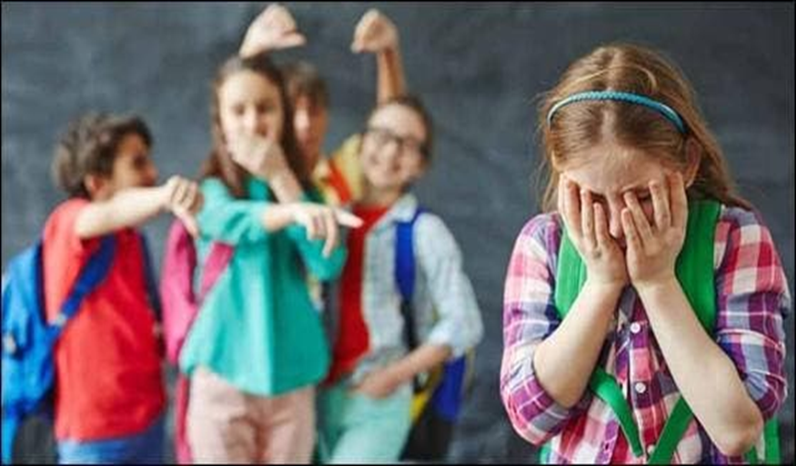
Where did the idea for the project come from?
The analysis of trends in the countries participating in the study of the phenomenon of bullying between 1993/1994 to 2005/2006 shows that there was no change in the reduction of the phenomenon in Poland, yet the scale of the problem in other countries, e.g. in Italy, decreased.

Slide 5
Bullying in primary schools (2018)

Slide 6
The objective of the project
Reduction of bullying in primary schools in Poland - by raising the awareness of teachers, parents and students about the symptoms and long-term consequences of bullying among students. It can be done by increasing their social skills, i.e. assertiveness and empathy, the high level of which minimizes the occurrence of bullying among young people

Slide 7
A tool supporting teachers and parents in prevention of bullying in the classroom and at home is the international method of Positive Discipline (according to the results of the UNESCO report from 2019), which strengthens the mutual bond between adults and young people. It also builds a relationship based on trust and mutual respect, which is key in bullying prevention, reduction of negative phenomena and encouraging young people to cooperate with adults.

Slide 8
Using Positive Discipline method by adults I upbringing of children brings positive effects in building important social competences (cooperation, empathy, assertiveness, effective communication, independence, self-discipline) in young people, thus preventing the phenomenon of peer violence.

Slide 9
Why doesn’t being strict do the job?
Consequences of strict upbringing:
(shouting, obsessive control, putting the person down, making them feel guilty, physical and psychological punishment, comparing to others)
low self-esteem.
feeling of guilt.
Sensation of not being good enough.
Self-destructive behavior.
Low self awareness (I don’t know who I am, what I want, what is good for me)
Excessive rebellious attitude
Excessive submissive attitude
Withdrawal, fear, distrust

Slide 10
Why doesn’t overindulgence do the job?
Consequences of over-indulgent upbringing:
(lack of boundaries and limits, being overprotective, fulfilling whims not needs)
Low self control of emotions
Inadequate self esteem
“The I deserve” attitude
Feeling of helplessness
“The Peter Pan” syndrome
Higher tendency to become addicted
Difficulty in playing by the rules

Slide 11
Positive discipline
The consequences of democratic (authoritative) upbringing
(relationship, setting boundaries while respecting the needs of a child, explaining your decisions, assertiveness and kindness at the same time, giving choice, learning from mistakes, no punishments, making contracts, relationship, closeness)
Adequate self esteem
Good social skills
Feeling of independence and decisiveness
Self awareness (I know what I want, who I am and what my strengths and weaknesses are)
Assertiveness in relationship with others
Responsibility and the will to develop

Slide 12
Basic PD tools
The message is firm and kind at the same time
Limited choice
Making (writing) contracts
Creating plans
"Decide what you will do"
Questions instead of commands
Focus on the solution
Natural consequences
Logical consequences

Slide 13
PUNISHMENT versus CONSEQUENCES
Punishment
Consequence
Objective: to make the child pay for undesirable behavior
It is unrelated to the offense
Disrespectful
It encourages rebellion, lying, or blind obedience
It weakens the relationship with the adult
It lowers self-esteem
It is ineffective in the long term
Objective: The child is to learn from the mistake made
It is directly connected with the offense
Full of respect for the child
It encourages you to look for solutions and learn from mistakes
It strengthens the relationship with the adult
It strengthens self-esteem
Effective in the long term

Slide 14
CHILD behavior is just the tip of the iceberg
THE NEED FOR BELONGING AND BEING VALUEABLE

Slide 15
The 4 wrong goals (motives) of behavior
according to the Dreikurs theory
drawing excessive attention to yourself - the belief that you are important when you are the center of attention
gaining power - it is the belief that only those who are strong command, deserve recognition
revenge, the criteria of belonging to a group is to repay with the same coin for the wrongs suffered, I am hurt so I can hurt others
lack of self-confidence - it's proving to others that you're not worth much, therefore you don't try

Slide 16
EXCESSIVE ATTENTION
The need for EXCESSIVE ATTENTION comes from the belief that "I only belong when I'm the center of attention"

Slide 17
ATTENTION - what to do?
Involve your child in some activity
Give non-verbal signals

Slide 18
POWER (AUTHORITY)
The child wants to belong, to be needed, but does not know how to achieve it. The only thing that comes to a child’s mind is to resist. If we give him limited power, space, then he will be able to use this power in a constructive way. We do not aim to take away the power of the child, but to give him a choice that is limited and acceptable to us.
.

Slide 19
POWER
The more someone tries to rule us, the more we resist.
That's why it's so important to get out of this misguided purpose of power in order to do something constructive.
Imagine you are clenching your fist and I am saying to you, "You know, I can't make you do anything. You will do what you decide. I just care and you would help me a lot if you opened that fist."
Would you like to open it? What happens then? I recognized you as decision makers…

Slide 20
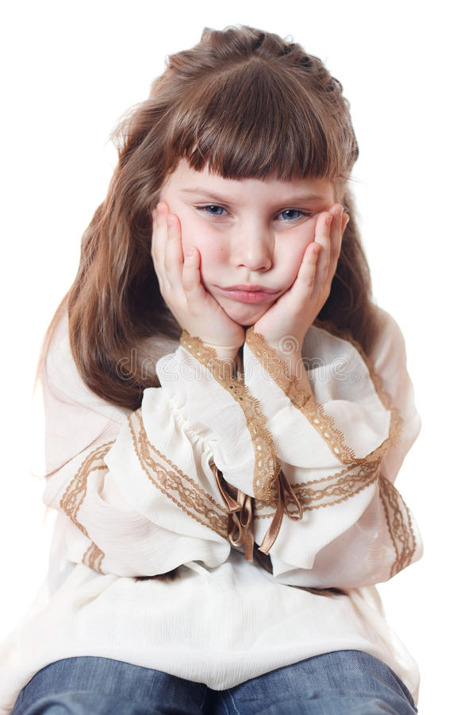
REVENGE
The child feels terrible and therefore makes us adults feel the same way. A strong need for revenge is activated
RECOGNIZE MY FEELINGS, I feel very bad deep inside

Slide 21
Revenge - what to do?
What our intuition tells us culturally is to disagree with such treatment. We think, "He's undermining my authority." We react to the tip of the iceberg (behaviour) by punishing the child. So we're only referring to behavior.
What happens then? We deepen the feeling of being unimportant and misunderstood.
The child begins to behave even worse. We are entering a vicious circle of revenge. The more we punish, the more intensive the revenge cycle.

Slide 22
Revenge
"You must feel terrible to be acting like this."
We notice a person with his/her emotions, not with behavior. We separate the child from his/her behavior
“Hearing what you say…I suspect you feel bad and I'm sorry about that. What would help you feel better about a decision I won't change?"
"At the same time, I don't approve of such comments because they are disrespectful."

Slide 23
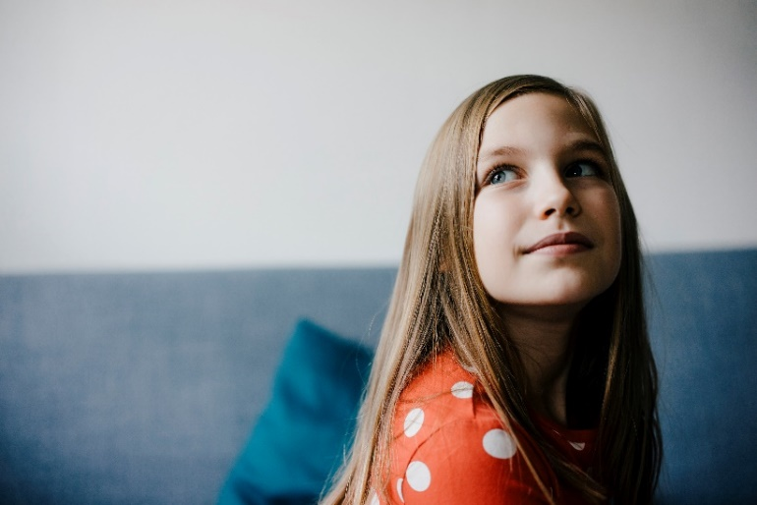
LACK OF FAITH
Show that you believe he can
Break the task down into small steps
-taking out notebooks, reviewing tasks to be done, choosing where to start doing homework, reading instructions, writing answers.

Slide 24
Lack of faith - what to do?
We can say: "Don't do homework for now, just take out your notebooks and mark with post-it-notes what is assigned. It will take you 2 minutes."
With such words, we encourage the kid to work and reduce the feeling of difficulty of completing a given task.
“Remember how we learned the multiplication table in grade 3? It seemed difficult at first too.” "Everything is hard before it becomes easy." ☺

Slide 25
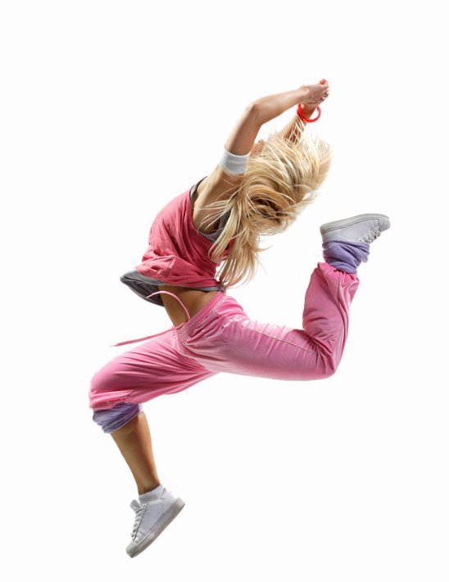
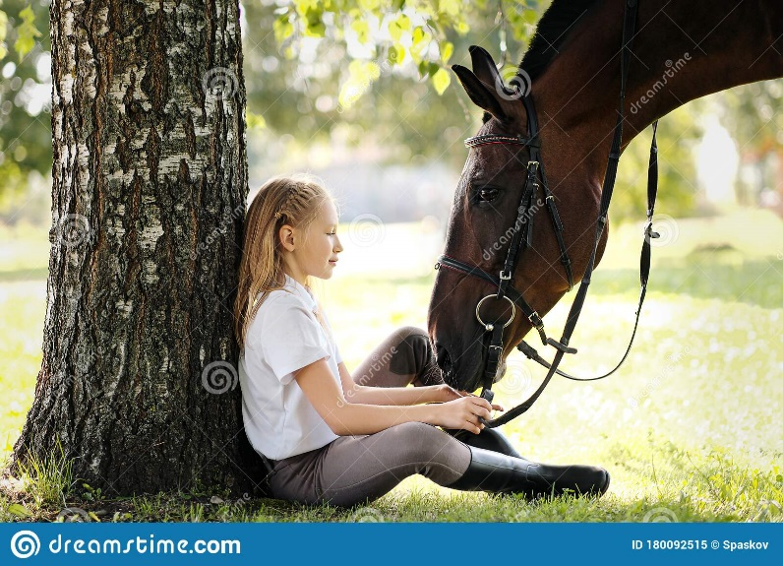
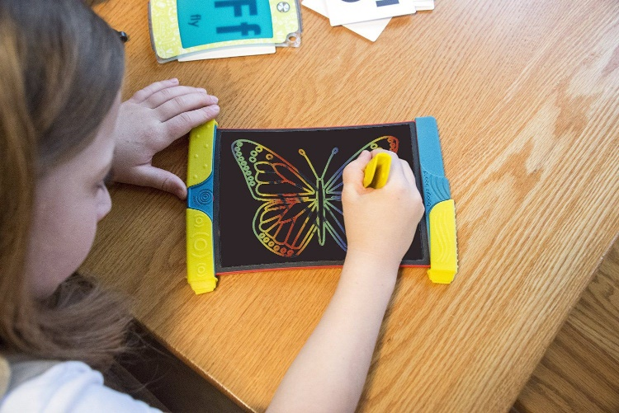
What predispositions does your child have?
What comes easily and naturally to your child?

Slide 26
Temperament
TEMPERAMENT is an important element of our personality, our nature, unchanged throughout life
(speed and intensity of reaction, mobility, high and low energy, greater or less susceptibility to fatigue, high or low resistance to stress, low or high sensitivity)

Slide 27
Types of temperament
Types of temperament:
Sanguine
Choleric
Melancholic
Phlegmatic

Slide 28
The sanguine
An optimist, can attract people to himself, open and spontaneous, has a great sense of humor. He has a lot of energy
Talkative, curious. He lives for today. He is the soul of the party, easily makes friends
He doesn't get angry, he likes to be the center of attention and apologizes quickly.
He searches for everything, loses, often forgets
Has a “Flash in a pan mentality”

Slide 29
The energetic choleric
A person of action, focused on doing and directing others, a natural born boss, leader of the herd,
Inspires trust and respect among people
A good organizer
Is able to distribute tasks and organize work to others
Impatient and often speaks before thinking
Explosive ;)

Slide 30
Phlegmatic
Observer
Calm, poised and patient, quiet and at the same time cheerful
Reluctant to share the emotions he hides deeply.
Kind, polite, friendly
He can sympathize and care.
Can listen!
Slow, has less energy.
Radiates calm

Slide 31
Melancholic
Thinker and pessimist
Sensitive to beauty, musical.
Dreamer
Characterized by conscientiousness, great sensitivity to the needs of others and a tendency to sacrifice himself.
He chooses his friends carefully, he is distrustful
Prefers to remain in the shadows, so he will avoid speaking in front of the group
Persistent and precise, orderly organized, he always has to finish what he started, if he promises something - he keeps his word

Slide 32
How is a Child's SELF-ESTIMATE created?
What he hears from us parents about himself
What he hears from teachers and classmates

Slide 33
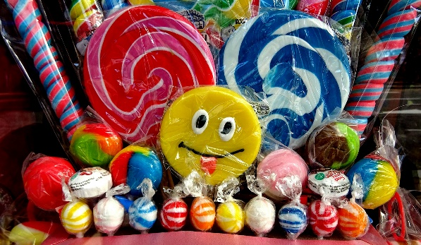
PRAISE versus ENCOURAGEMENT
Praise is like sweets:
Encouragement is like a nutritious meal
It refers to the doer “good girl"
Evaluative ("nice..")
What will others think... Is it pretty ma'am?
Emphasizes the end result ("you did it perfectly")
Refers to the action itself - "good job"
Appreciative ("I appreciate…")
What do I think about it.. Do you like it?
Emphasizes commitment and process " I can see how hard you tried..."
To zdjęcie, autor: Nieznany autor, licencja: CC BY

Slide 34
SOFT skills that minimize violent behavior among children and adolescents

Slide 35
ASSERTIVENESS
having own opinion and the ability to express it, even if it differs from the opinion of others
the ability to say no without hurting others
the ability to set boundaries for other people without offending them
the ability to express one's emotions without hurting others
Children train assertiveness by saying NO to parents ☺

Slide 36
EMPATHY
The ability to recognize other people's emotions
The ability to empathize with another person
It allows us to feel like another person for a moment, to understand what he is feeling
A child learns empathy by experiencing it from adults

Slide 37
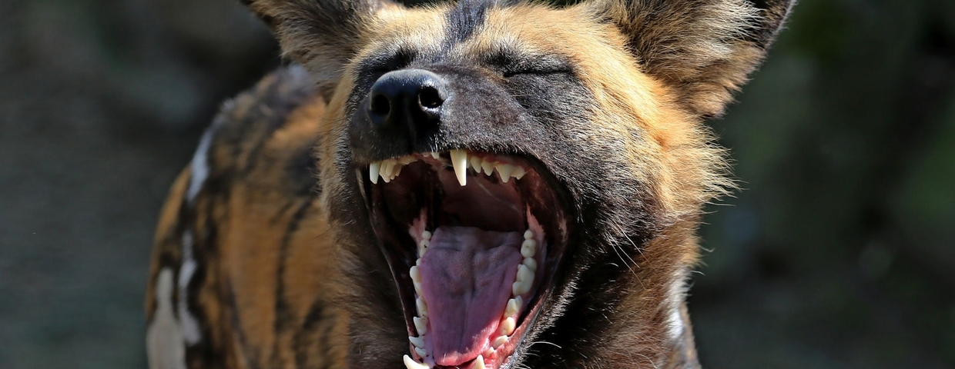
COMMUNICATION Non-Violent Communication (NVC)
The language of the giraffe versus the language of the jackal

Slide 38
The language of the Jackal: The YOU message
Stop talking!
You never listen to me!
Your problem. You're lazy so you got a bad grade!
Why can't you behave like others?
I can't talk to you normally!
You are oversensitive! Don't be hysterical!
Don't feel sorry for yourself, others have it worse than you!
WHAT DO THEY CONTAIN?

Slide 39
The language of the Giraffe: the I message
It only says something about me, about how I feel about the other person's behavior
"I'm sorry that you don't call me back„
INSTEAD OF – You'll never call me back! You do not care about me!

Slide 40
The language of the Giraffe: the I message
It bothers me that you interrupt me again.
I feel ignored when you text while talking to me
It's hard for me to hear that I'm oversensitive. My feelings are being judged, it doesn't help
You have no permission to talk to me that way
I need YOU to help me this time
WHAT DOESN’T IT CONTAIN?

Slide 41
The ADVANTAGES of "the giraffe language"
it does not judge the other person,
is concrete, based on facts,
it is personal, so it increases the level of openness in the relationship
The YOU message: "You are selfish. As usual, you're not listening to me!"
The I message: "I feel ignored when you look at your phone when I'm talking to you"

Slide 42
Find the “I message" (in the following):
I don't like it when you're late for class.
Stop feeling sorry for yourself and start learning.
It bothers me that you're talking now while I’m teaching
You're a latecomer like no other!
It's your fault! Because of you I didn't manage to finish the test
You're lazy, you always keep putting things off until later
I can't concentrate in this noise
It's hard for me to teach when you're talking
I feel angry when you talk to me like this

Slide 43
Replace the “YOU message” with the “I message”
"You always interrupt me when I'm talking"
……….
"You never listen to what I say"
…………
"You keep taking my charger without permission"
…………
"You're so disorganized! How could you lose the keys?„
………..

Slide 44
The 4-step model of Nonviolent Communication
1. Expressing feelings:
I feel / I don't like / I am / it disturbs me (when)………
2. Description of the facts which we refer to - without judgment.
When you …. (description of facts)
3. Expressing your needs:
Because I need…..
4. Expressing your expectations - that is, asking for specific behavior in the future:
I expect that next time ...

Slide 45
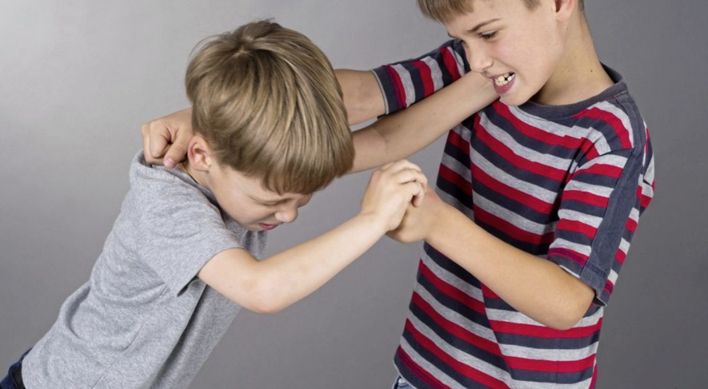
The ability to solve conflicts

Slide 46
Mistakes made by adults during children's conflicts:
Investigating, who started it? Determining who is guilty.
Taking the side of the child who is crying
Generalizing - you always….
Judging
Threatening
Showing pity
Giving a ready solution, e.g. "apologize and avoid each other and go to your rooms"

Slide 47
How to optimally accompany children during a conflict?
Stan, Tom - I want to talk to you, because I see that something is going on between you two. I would like to help you find a solution to this situation because I have the impression that it is difficult for you..
Stan, you were upset with Tom because he demolished your first block tower, right? You wanted him to be careful because you worked hard on her, right?
Tom, I can see that you are also nervous and you are sad because your brother pushed you hard and you fell, right?

Slide 48
What is worth doing in the case of children's conflict?
Question:
What happened that made you react like that? – to get to know both perspectives.
Questions full of curiosity:
How do you feel about it now?, how does your friend feel, what do you think? What does this situation teach you?
Searching for a solution.
What ideas do you have for resolving this conflict/repairing the harm?
A lesson for the future.
What do you need to do next time in a similar situation so that it doesn't happen again?

Slide 49
What is BULLYING?
It is regular, long-term exposure to harmful actions by other students, the purpose of which is to cause him/her psychological pain (humiliation, causing distress and a sense of rejection)

Slide 50
Does this concern my child?
Parents/guardians would certainly never want their child to participate in or experience bullying but in reality, over 60% of children and adolescents aged 11-14 experience this phenomenon - as perpetrators, victims or as witnesses

Slide 51
3 FEATURES OF BULLYING
Characteristics of bullying according to D. Olweus (2007)
Intentionality (wg. Tabeli poniżej)
Action intended to cause harm
Not always present at the early stage
Repetition
Refers to “smaller” acts committed over a longer period of time
in the case of relational violence, it relies on persistence
Imbalance of power
the victim becomes helpless and stops defending himself/herself
it may be due to physical superiority however it often results from other factors

Slide 52
TYPES OF BULLYING
Physical:
hitting, spitting, pulling, pushing
destruction or theft of another student’s belongings such as clothes, notebooks, phone.
Verbal:
Calling names, making fun of, insulting or vulgar remarks
Gossiping about the person
Cyber violence:
Sending out insulting texts by smart phone or internet
Sending out compromising photos of the victim
Attacks on online forums
Relational
Exclusion from common activities
Not communicating/ ignoring the victim
Manipulating others so that they alienate the victim

Slide 53
SAD FACTS
90% of young people in schools think violence is wrong, but only 17% react when they witness violence. fear of exclusion, lack of acceptance of the peer group wins over the reaction to violence at school. Students very rarely tell teachers and parents about the bullying they experience because they believe that teachers can do little or nothing about it and that the parents' reaction can make it worse, so they suffer alone.

Slide 54
Which is NOT bullying?
An argument or fight that happens once in a while after which everything goes back to normal
Unpleasant verbal exchange between friendly children followed by reaching agreement
A dispute or a break-up

Slide 55
How to help a child experiencing peer violence?
Reassure the child that it's not his fault. Peer violence is still associated with a sense of shame, and some children may get the impression that they themselves are the cause of these incidents.
You can remind the child that many people have also experienced peer violence. Being a victim of bullying is not a sign of weakness, and showing violence is also not a sign of strength.

Slide 56
Encourage your child to try to appear confident, even if they don't feel that way. Perpetrators of peer violence usually want to provoke a reaction and make someone feel sad. If a child gives the impression that these behaviors do not impress him, he is more likely to stop bullying.
You can encourage the child to think back to the situation and think about how it could have been done differently to get a better result
Various scenarios can be practiced at home so that the child can prepare to cope with difficult situations.
The child should be taught to be assertive and decisively say "No”

Slide 57
WHY DO SOME CHILDREN HURT OTHERS?
People naturally gather in groups based on similarities and move away from dissimilar groups. Therefore, it is important to teach the child respect, tolerance, acceptance of others.
They feel unhappy and take out their sadness, anger and grief on others.
They experience violence at home and take it out on the weaker ones at school
They have low level of empathy and self-esteem and they do everything they can to prevent others from noticing it

Slide 58
The long-term effects of bullying
social anxiety
depression
suicidal thoughts – there is a term called bully-cide (suicide resulting from bulling)
lower self-esteem
psychosomatic disorders such as insomnia, bedwetting and inhibited appetite

Slide 59
The short-term effects of bullying
Severe feelings of humiliation, fear, despair and sadness, a sense of loneliness, low self-esteem, powerlessness or helplessness.
At the same time, victims may feel great anger, grief and hatred towards the perpetrators, but also towards the witnesses who did not react and did not help.
Experiencing such emotions has a negative impact on concentration and, as a result, on academic performance. Victims usually think negatively about themselves, e.g.: “I am useless”, “I am different”, “something is wrong with me”.

Slide 60
How to talk to the bully?
Bullying is bad behavior, which means that it must be stopped, but it does not mean that a child who behaves in this way is a bad person.
It is worth separating the child from his behavior so that he maintains his self-esteem
It is much more effective to make it easier for the child to understand that their behavior is unacceptable and to explain its impact on others.

Slide 61
How to help a child experiencing bullying?
It is important to understand his perspective and appreciate even a little honesty on the subject, which probably costs him a lot. If the victim meets understanding during the first contact, it will be easier for her to continue the conversation.
In the event of denial or trivialization by an adult, the problem solving process will be stopped
.

Slide 62
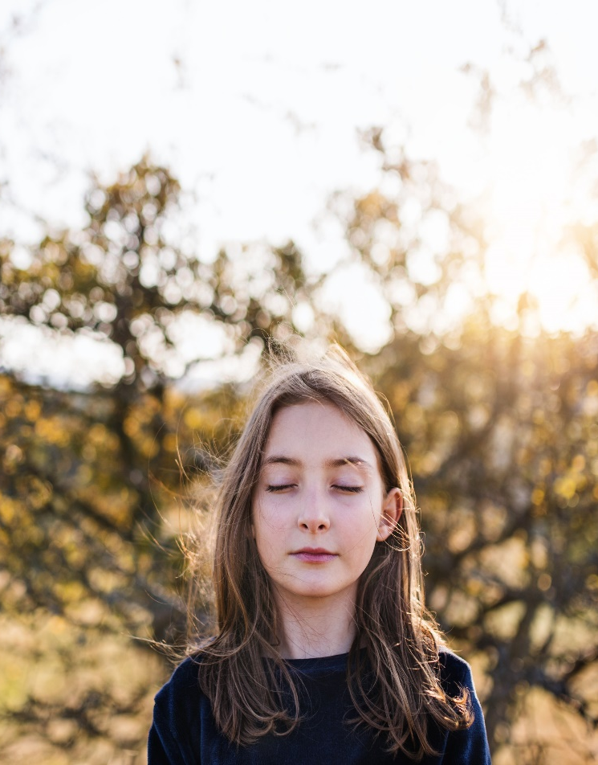
SYMPTOMS of experiencing violence.
Sadness, crying, self-isolation, avoiding contact with others
Indifference, resignation from interests
Constant fatigue and lack of energy, drowsiness
Critical thinking about oneself
Talking about death
Tantrums, aggression, self-aggression (mutilations)
Fears limiting daily functioning
Suppressed appetite or binge eating
Psychosomatic complaints: e.g. headaches, shortness of breath, abdominal pain
Difficulties with concentration, memory, deterioration of grades

Slide 63
A child who SUDDENLY deteriorated in learning and behavior...
May be a victim of peer violence (bullying, cyberbullying)
Maybe he is experiencing difficulties at home (parents' divorce, loss of a parent's job, death of a grandpa, pet, unrequited love)
May not understand the scope of the material
Maybe he got addicted to the screen
He may be suffering from depression
Or he wants to get the attention of parents who are too busy with other things

Slide 64
How to support a child experiencing bullying
Reassure your child that it is not his fault and that you will work through this together
Ask for needs. Ask your child what he needs most from you right now.
Inform the school. The child may be afraid to tell teachers about problems
Take care of safety. If your child has been hurt, don't let it happen again. The school has a legal duty to keep your child safe and must work with you to do so.

Slide 65
Talk to a specialist. If your child is anxious or very scared and you feel that bullying has seriously affected their emotional health, see a psychologist.
The better your child thinks of himself, the less likely that bullying will severely lower his self-esteem. Encourage extracurricular activities that bring out the best in your child. Show your appreciation.
Provide your child with opportunities to meet friends outside of school to help build a strong support system. Try to reach out to parents in the neighborhood, the local community, places with extracurricular activities. The more often your child practices social skills in a safe environment, the better

Slide 66
How to encourage your child to find a solution?
Help your child see what the outcome of their words and actions can be. “What do you think you can say the next time someone does this to you? What do you think could work?
For example, your child may get the idea to tell the abuser, "Leave me alone, moron." Then, instead of telling your child, "That's a bad idea," say: "What do you think will happen if you do this? How will that help?”
Let them understand that bullying may escalate if they resort to attack/name-calling/retaliation.
Your child may then say, "I could walk away from that person, ignore them." You can suggest that he walk away the first time and say what he has to say if ignoring doesn't work.
It is also important to ask your child the following question: "What will make you feel better about this situation?" But make sure you're not the one coming up with the solution. It is important that your child feels that he/she is the one who is solving the problem testing different strategies.

Slide 67
What if it is your child who is the bully?
Step 1. Manage your reactions and get the facts right.
Try to stay calm - although it's hard to listen to what other people say about your child.
Thank the parent or teacher for letting you know and say that you take this very seriously and that you will do everything in your power to stop this behavior.
Step 2. Talk to your child
Try to stay calm and in control. Tell your child that you have been informed by a teacher/other parent and that you need to know what happened. If you stay calm and approachable, you can hear so much more. Avoid using threats or arousing guilt.
Explain that whatever happened, will happen, you will help the child through it. Ask your child: Do you know what they are talking about? What is your perspective? Why do you think your classmate sees it differently? How would you feel if he or she did this to you?
Make your child clearly understand that bullying is unacceptable and that it must stop

Slide 68
Step 3. Work on resolving the situation
Take it seriously. Don't ignore your child's behavior with the "just this one time" excuse - it won't go away. Even if you are not concerned about the long-term effects on your child, another child is being harmed and it can NOT be allowed to continue.
Support the school anti-bullying policy. Find out what their approach to bullying is. Talk to the teacher-advisor. Say that you want to be in regular contact and find out how your child is doing.
Try to understand what led to this. Think about the possible reasons why your child might be behaving this way.
Think about what is going on at home - do a "review" of your family
• Is your child worried about some problem at home (death of a pet, moving house, parental argument or separation)?
• Is someone in your home abusing (mentally or physically) your child (parent, family member or another adult)?
• Is he/she jealous of his brother or sister?
• How do you assure your child of your love and do you show interest in your child's life?

Slide 69
Mistakes made by parents of children who are perpetrators of violence
They are looking for somebody else to blame - "He/She didn't learn it at home. It must be the school's fault!"
They belittle the behavior by saying, "These are just conflicts between kids." They'll get over it..
They say, "I know my child and he would never do that!" You don't necessarily know "who" your kid is among his peers
They contact the parents of the alleged victim directly - this can only escalate the problem.

