Slide 1
The program of workshops for grade 4-8 students
Erasmus+ project „I am OK, you are OK”
Project goal: raising awareness of bullying and cyberbullying prevention processes among primary school employees. and educators outside
of school
Website: https://weareok.pl/

Slide 2
Materials were developed by:
Fundacja Edumocni, Polska https://edumocni.pl/
Justyna Kołodziej – Kozub https://www.facebook.com/profile.php?id=100059272547940
Bluebook srl, Włochy https://www.bluebook.it/
Monica Pomero, Letizia Zucchelli
Funded by the European Union. Views and opinions expressed are however those of the author(s) only and do not necessarily reflect those of the European Union or the European Education and Culture Executive Agency (EACEA). Neither the European Union nor EACEA can be held responsible for them.
Attribution 4.0 International (CC BY 4.0)

Slide 3
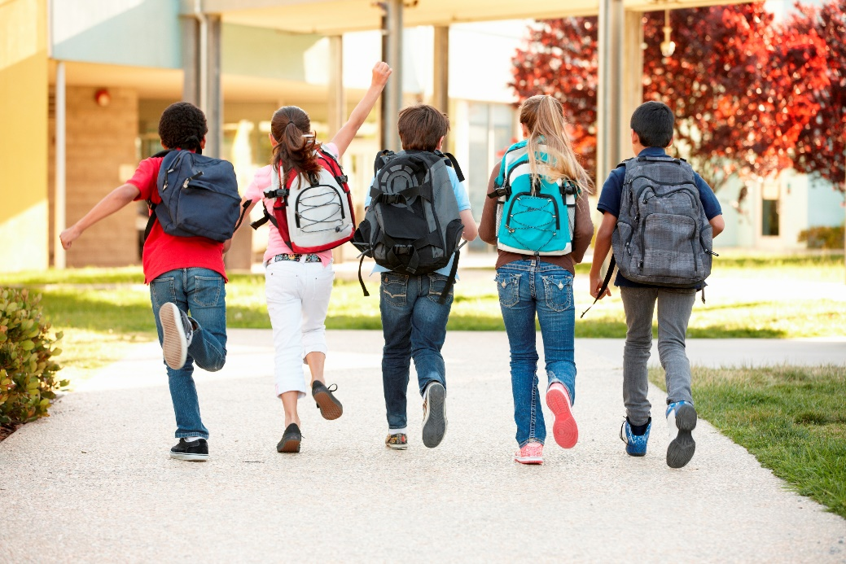
Workshops dedicated to empathy and counteracting bullying
2022

Slide 4
Who am I?
Getting to know yourself as a condition to happy life and healthy relationship with people

Slide 5
TEMPERAMENT
Temperament is an important element of our personality, our nature, unchanged throughout life.
(speed and intensity of reaction, mobility, high and low energy, greater or lesser susceptibility to fatigue, higher or lower resistance to stress, low or high sensitivity)

Slide 6
Temperament
Types of temperament:
Sanguine
Choleric
Melancholic
Phlegmatic

Slide 7
Sanguine
Optimist, able to attract people, open and spontaneous, has a good sense of humor and a lot of energy
Talkative, curious. He lives a day at a time. He's the soul of the party. Makes friends easily.
Doesn't get angry, likes to be the center of attention, apologizes quickly.
He looks for everything, loses things, often forgets.
A flash in the pan type of person.

Slide 8
Energetic choleric
Action-oriented, a natural-born boss, leader of the herd☺,
Respected and trusted by people
Good organizer
Able to allocate tasks and organize of others
Impatient, often acts first thinks later
Explosive ;)

Slide 9
Phlegmatic
An observer
Calm, poised and patient, quiet and cheerful at the same time
Reluctant to share emotions hidden deep inside.
Kind, polite, friendly
Can sympathize and care.
A good listener.
Slow, not too energetic.
Radiating calm.

Slide 10
Melancholic
Thinker and pessimist
Often sensitive to beauty, musical.
Dreamer.
Very sensitive to the needs of others, dedicated, conscientious.
Chooses friends carefully, distrustful.
Prefers to remain in the shadows, avoids public speaking.
Persistent and precise, orderly
Organized, always has to finish what he started, keeps his promises

Slide 11
Which is THE BEST?

Slide 12
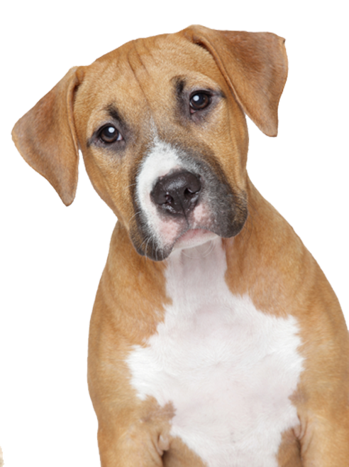
Can they be compared? WHO is nicer?

Slide 13
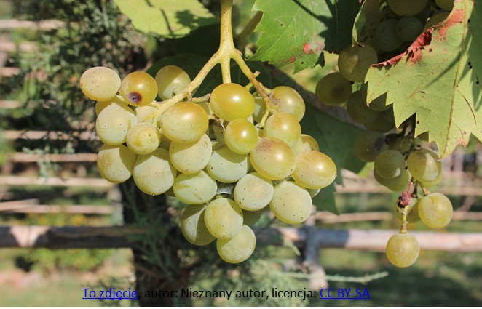
What is more delicious?

Slide 14
What is better?

Slide 15
Which place is more enjoyable?
The sea?
The mountains?

Slide 16
What does this prove? ☺
Everyone is different and unique
It's not worth comparing yourself to anyone
Each personality has advantages and disadvantages
Some people will like you for your traits of character, and others will avoid you for the very same traits.
Be true to yourself and stick with those who appreciate you just the way you are!

Slide 17
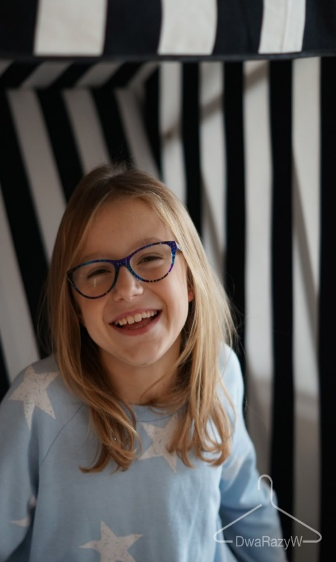
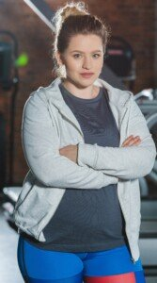
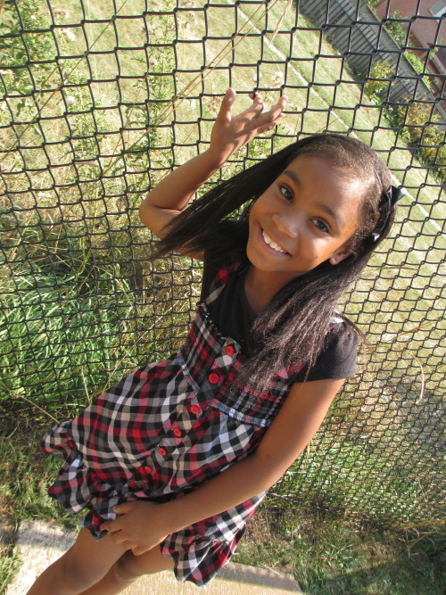
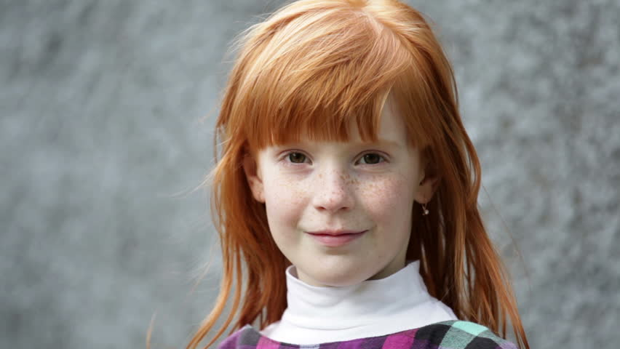
We differ beautifully!

Slide 18
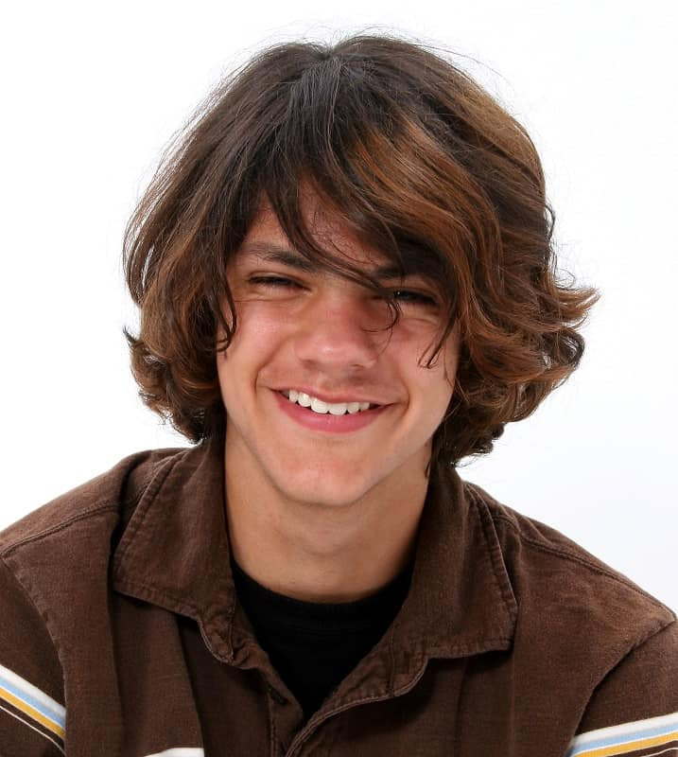
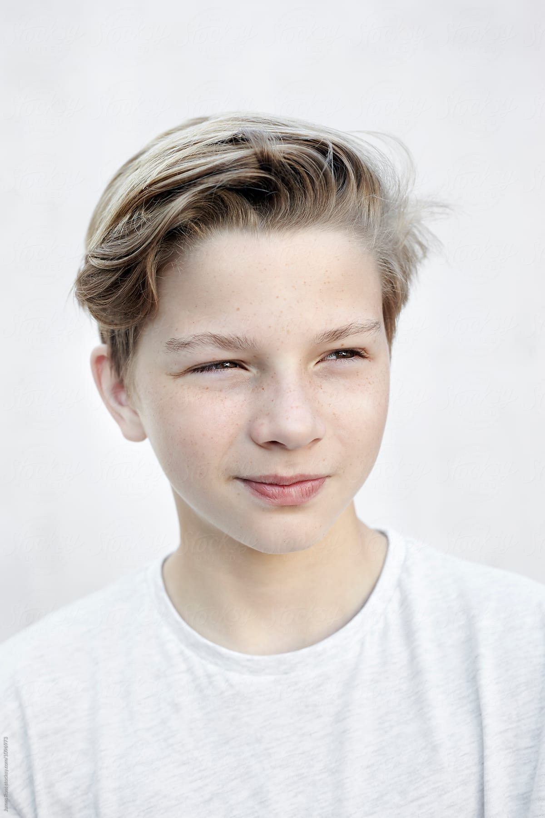
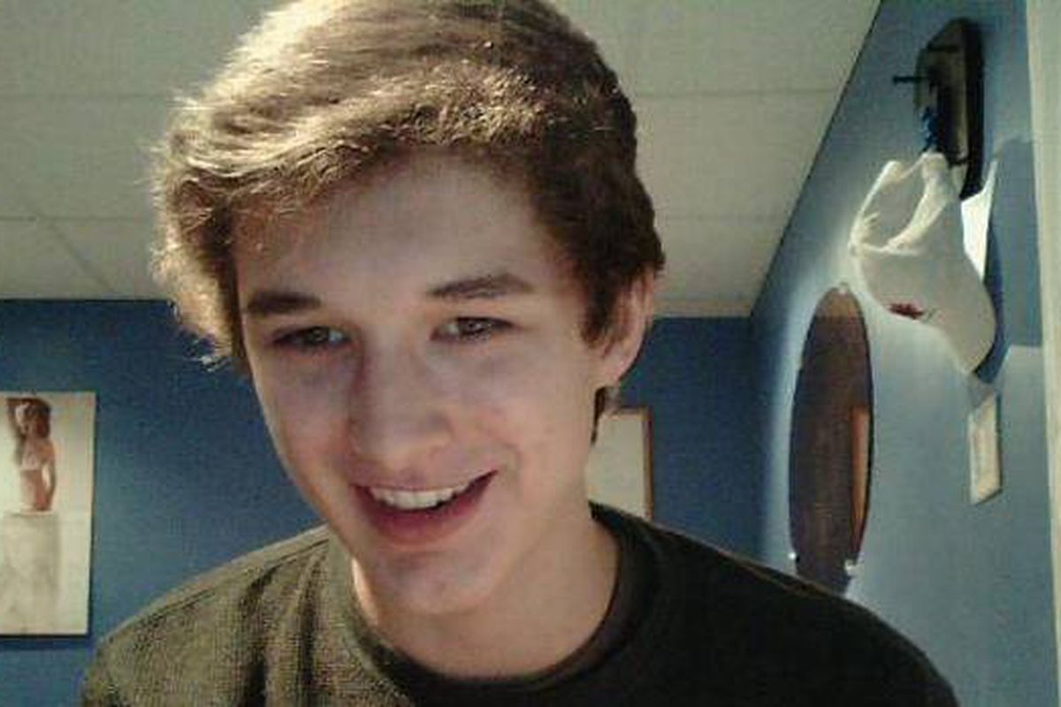
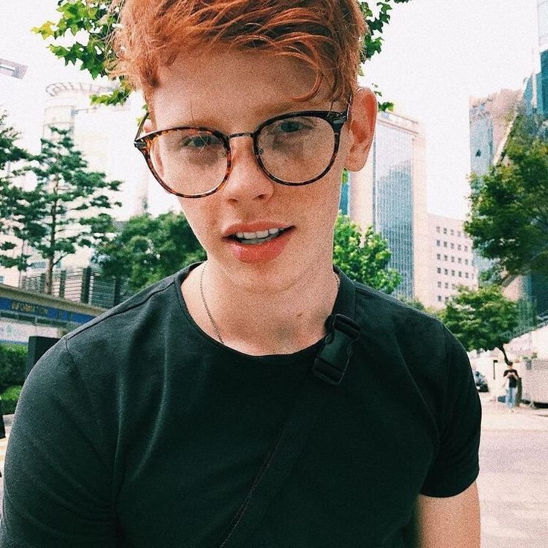
We differ beautifully

Slide 19
Strengths

Slide 20
STRENGTHS
Good memory
Language skills
Ease of establishing relationships
Artistic/musical talent
Physical fitness
Culinary skills
Acting skills
Comforting/supporting others
Mathematical skills
Photographic sense
Leadership skills
Radio voice ☺
Good sense of humor
PATIENCE
EMPATHY
PROTECTION
ACCURACY
Good at spelling
Good aesthetic sense
Good contact with animals

Slide 21
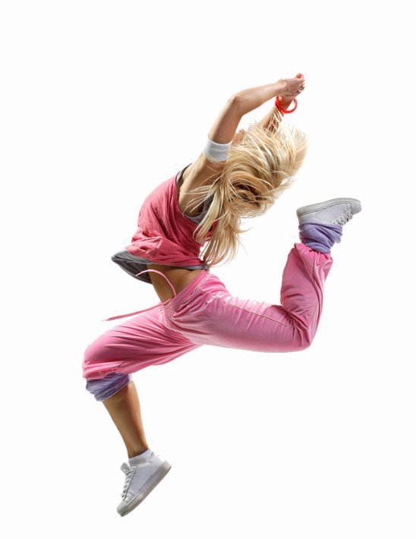
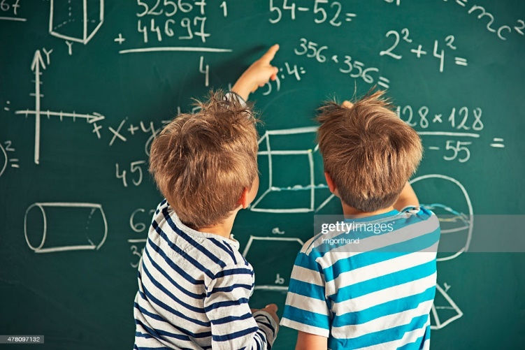
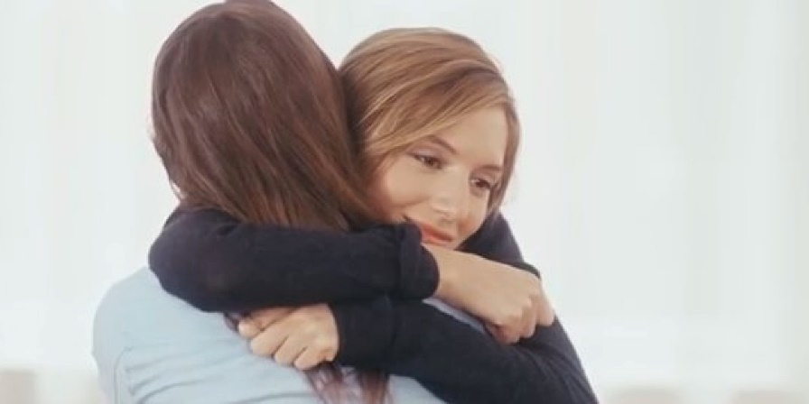
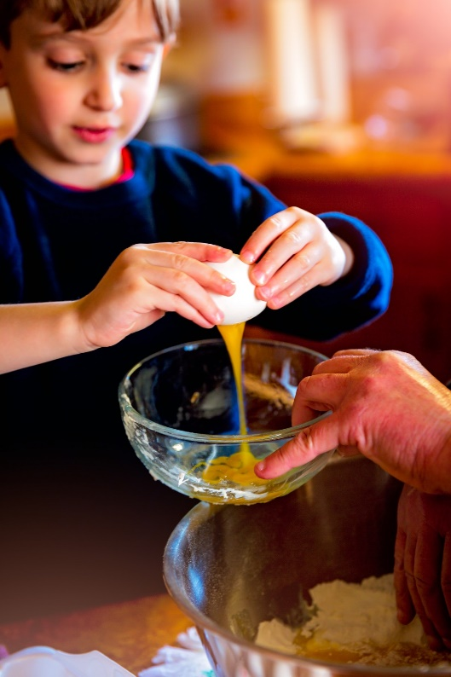
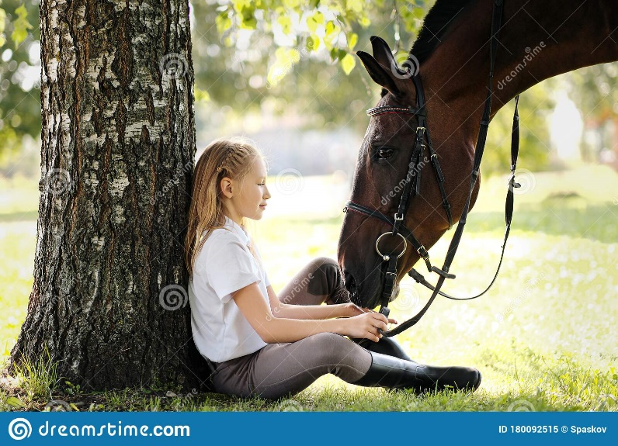
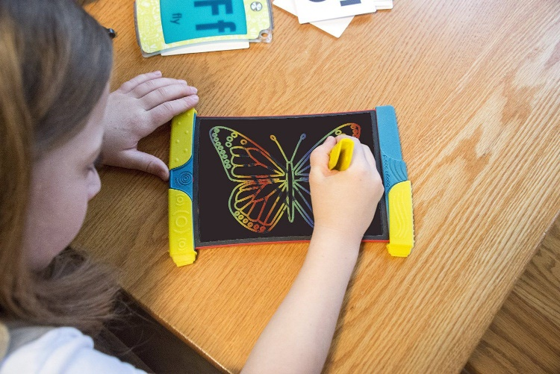
Each one of us has a unique set of strengths

Slide 22
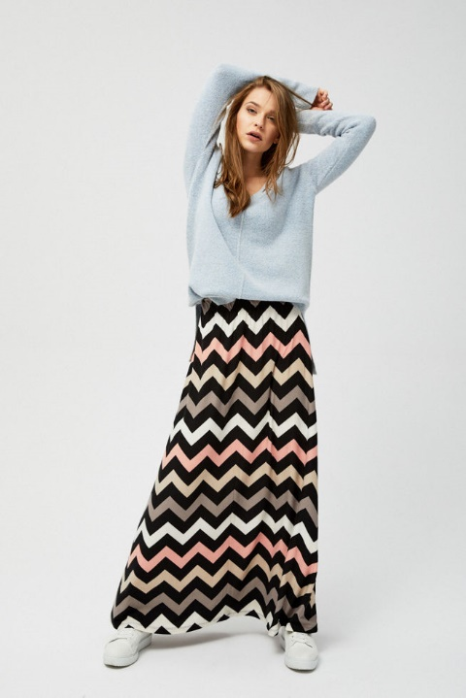
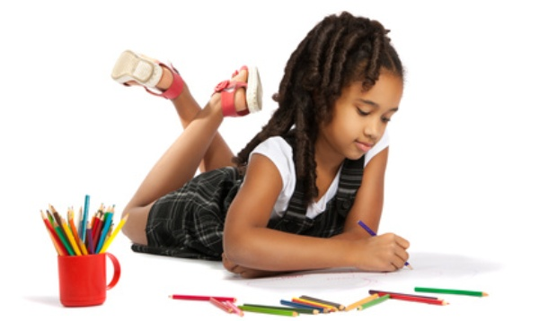
Not every girl has to
Love painting and be interested in fashion
Like glitter and pink color
Have long hair
Wear skirts
Have a neat handwriting

Slide 23
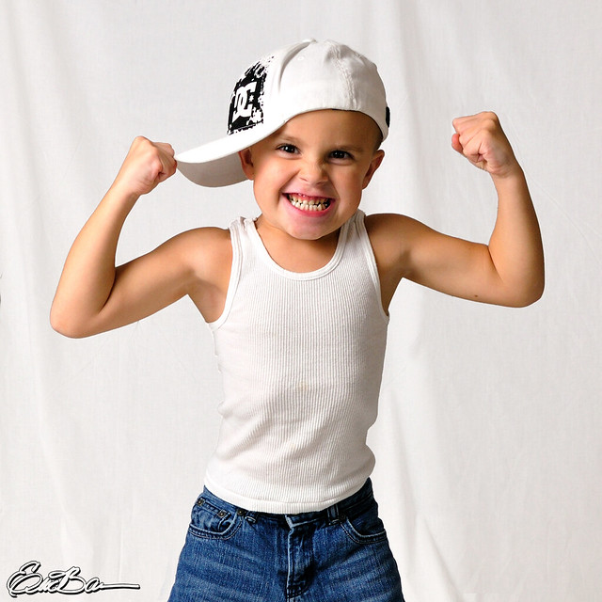
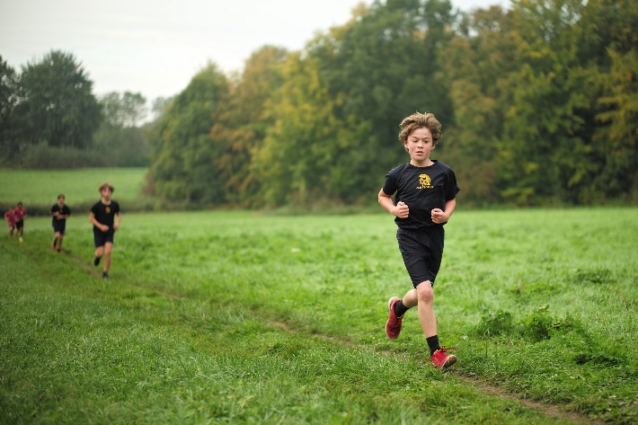
Not every boy has to
Be interested in cars and football
Like PE (Physical Education)
Be physically strong
Have short hair

Slide 24
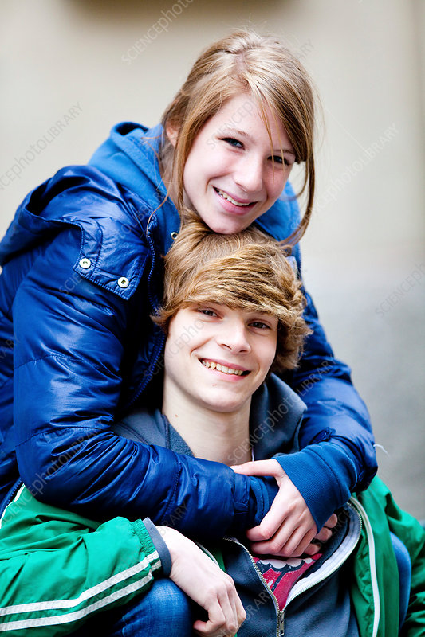
SELF-ESTEEM
our self-esteem is our evaluation of ourselves based on what is happening in our life and how we explain it to ourselves
varies depending on who we compare ourselves to what we hear about ourselves from parents, friends and TEACHERS

Slide 25
Types of self-esteem
HIGH
LOW
ADEQUATE

Slide 26
INTERPRETATION of what happens to us

Slide 27
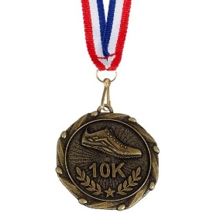
Self-esteem “the 3rd place – THE BRONZE MEDAL”
Low self-esteem„
" Oh no! I'm last, only the 3rd place"
"Too bad I didn't do as well as my friends"
"I'm the worst out of the three"
"I have bad luck"
Adequate self-esteem
"Wow! I'm on the podium - it's a success"
“I made progress because last year I was 7th”
"It was worth trying harder - there are effects"
"Maybe next year I'll be able even to get 2nd place"

Slide 28
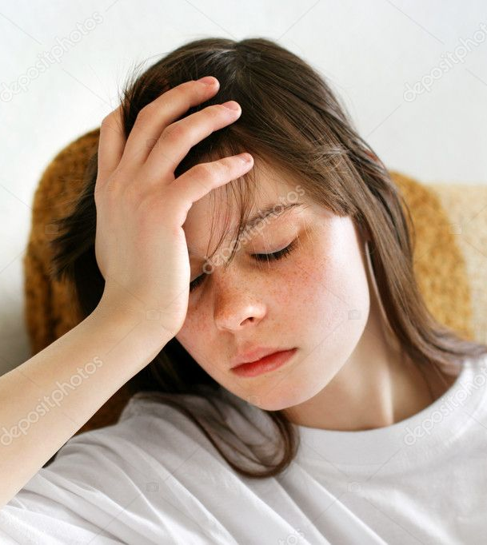
Low SELF-ESTEEM
means having a very unfavorable opinion about yourself,
a person with a low level of self-esteem is passive, reluctant to any activity, isolates himself from others, is dominated by sadness, fear, pessimism, is submissive, afraid to refuse others
feels inferior to others

Slide 29
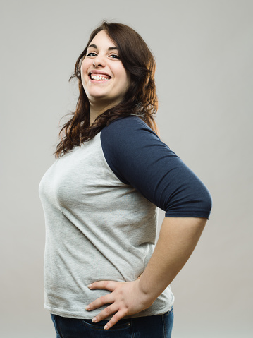
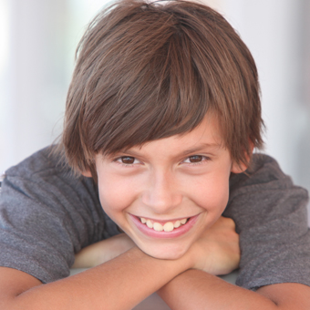
Correct SELF-ESTEEM
I know my flaws and I accept them
NO ONE is and no one has to be perfect!
I know my advantages and I accept them!

Slide 30
10 year-old AREK
In the morning he heard from his dad:
"Hurry up, I'll be late for work again because of you"
At school during PE, he heard from a classmate: "You loser, we lost because of you!"
During the break, he heard from a classmate that he had "girly pants" and saw others laughing at him.
WHAT DOES HE FEEL?
WHAT DOES HE THINK ABOUT HIMSELF?
WHAT IS HIS SELF ESTEEM?

Slide 31
9 year-old ELA
She heard from her mother in the morning: "What are you crying about again, you crybaby? I've had enough of your hysteria!"
At school, the teacher said: "Ela, you got an F in mathematics again. Without math you will have a hard time in life”
Her classmates told her, "You're weird because you don't listen to popular music and you don't wear jeans and they kicked her out of the group on Messenger”
WHAT DOES SHE FEEL?
WHAT DOES SHE THINK ABOUT HERSELF?
WHAT IS HER SELF ESTEEM?

Slide 32
Despite your flaws and weaknesses (everyone has them) - you are unique and needed.
Name your strengths, focus on them and build your life around them.
We are like a puzzle - each piece is needed to create the whole picture. Each one is different and that's WONDERFUL

Slide 33
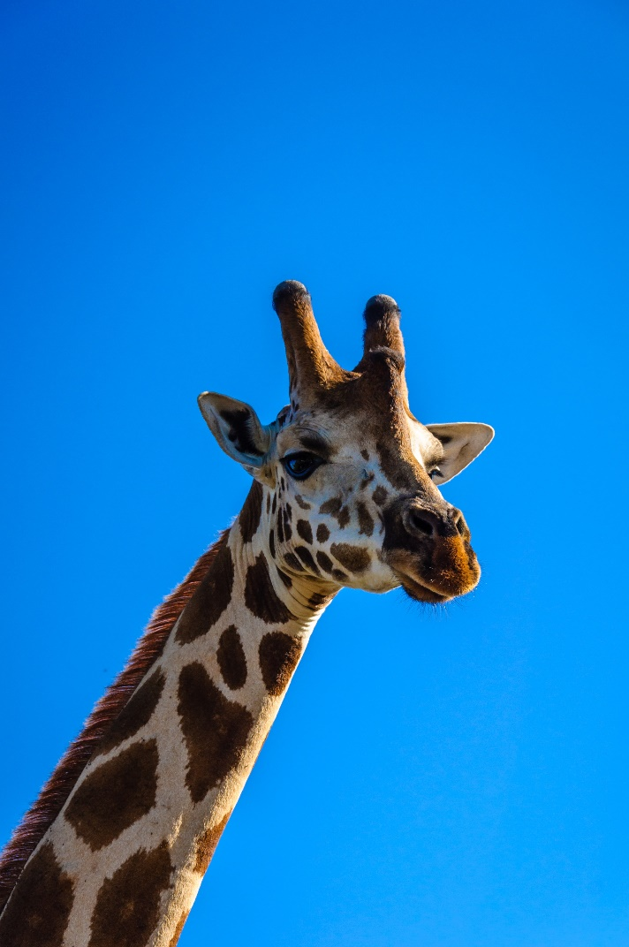
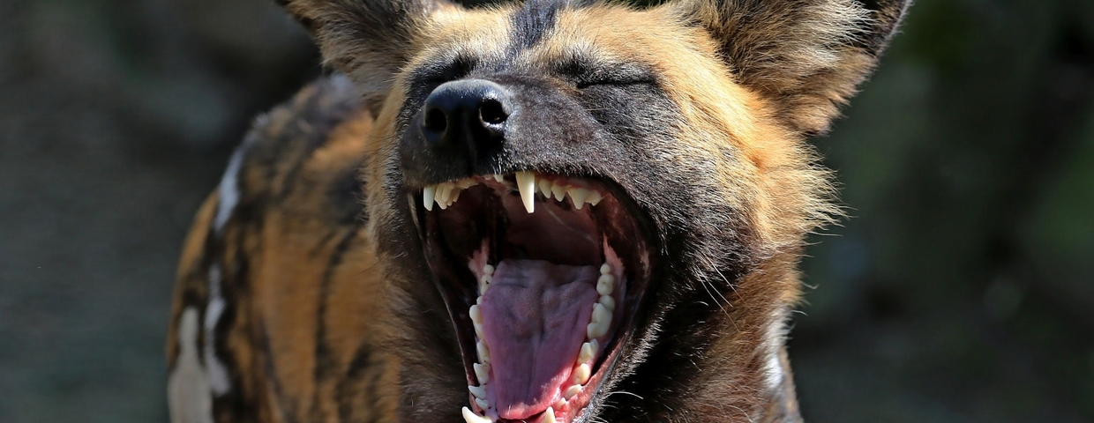
Nonviolent Communication (NVC)
The language of the giraffe VERSUS the language of the jackal

Slide 34
Language of the Jackal- the YOU message
You always decide where to go, I'm sick of it!
You never listen to me!
Your problem. You are… lazy, weird!
Why can't you act like the rest?
You can't talk normally!
You are oversensitive!
Stop feeling sorry for yourself! Others have it worse than you.
WHAT DO THESE MESSAGES CONTAIN?

Slide 35
Language of the Giraffe- the I message
It only says something about myself, my reactions and my feelings about the other person's behavior
"I'm sorry you don't call me back„
Instead of – You never call me back!

Slide 36
Language of the Giraffe- the I message
I don't like it when you always decide where we go, this time I want to decide.
I feel ignored when you don’t text me back.
It's hard for me to hear that I'm oversensitive, it's like my feelings are being judged.
I don’t allow you (or anybody else) to talk to me that way!
I need you to help me this time.
WHAT DON’T THESE MESSAGES CONTAIN?

Slide 37
ADVANTAGES of “giraffe language”
it does not judge the other person,
is concrete, based on facts,
it is personal, so it increases the level of openness in the relationship
the YOU message: "You are selfish. As usual, you're not listening to me!"
the I message: "I feel ignored when you look at your phone while I'm talking to you"

Slide 38
Find the "I MESSAGE"
I don't like it when you're late for our meetings.
Stop feeling sorry for yourself and start learning.
It bothers me that you're talking on the phone now.
You're extremely irresponsible, you're late
It's your fault, because of you I didn't manage to finish the test
You're lazy, you keep putting things off until later
I can't concentrate in this mess
I feel bad when you don't reply to me
I feel angry when you talk to me like this

Slide 39
Change the “YOU message” to the “I message”
You always interrupt me when I'm talking„
"You never listen to what I say„
"You keep taking my charger without asking„
"You are so messy, how could you lose my notebook?!"

Slide 40
The 4-step model of Nonviolent Communication
1. Expressing my feelings
I feel/I don't like/I am………………………………………………..
2. Description of the facts to which we refer - observations without judgment. When…………………………………… (description of facts)
3. Expressing my needs – Because I I need………………………………………….
4. Conveying your expectations - that is, asking for specific behavior in the future I expect that next time .......................

Slide 41
Are you a good team?
Do you all feel important and accepted?
Do you all feel good coming here?
Is everyone is helpful and supportive?
No one intentionally hurts anothers?

Slide 42
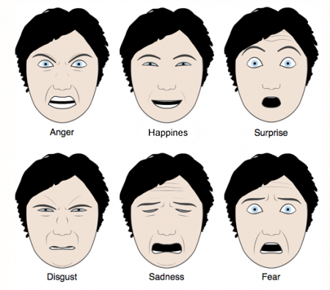
6 basic EMOTIONS
One of the main functions of facial expressions (microgestures) is to communicate our emotional states and attitudes.
There are 6 main facial emotions:
happiness,
surprise,
fear,
sadness,
anger,
disgust

Slide 43
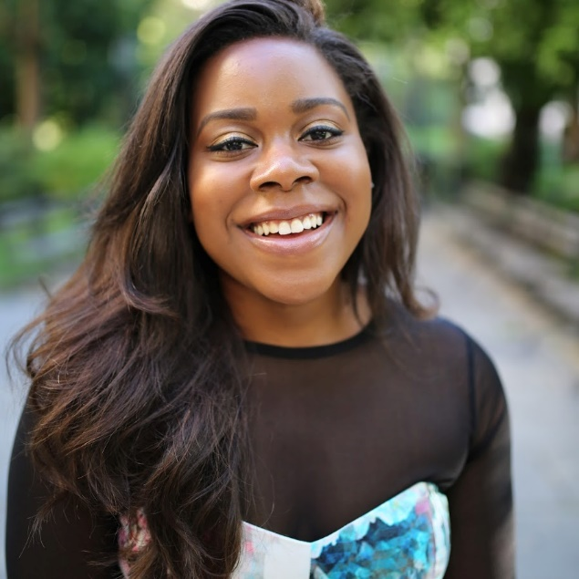
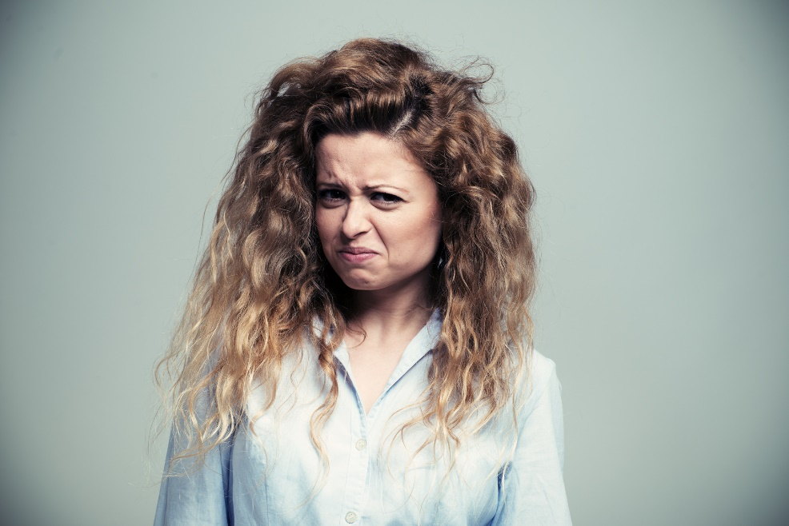
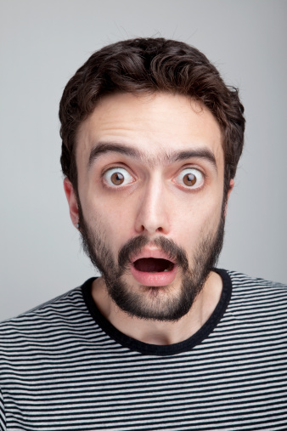
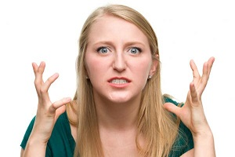
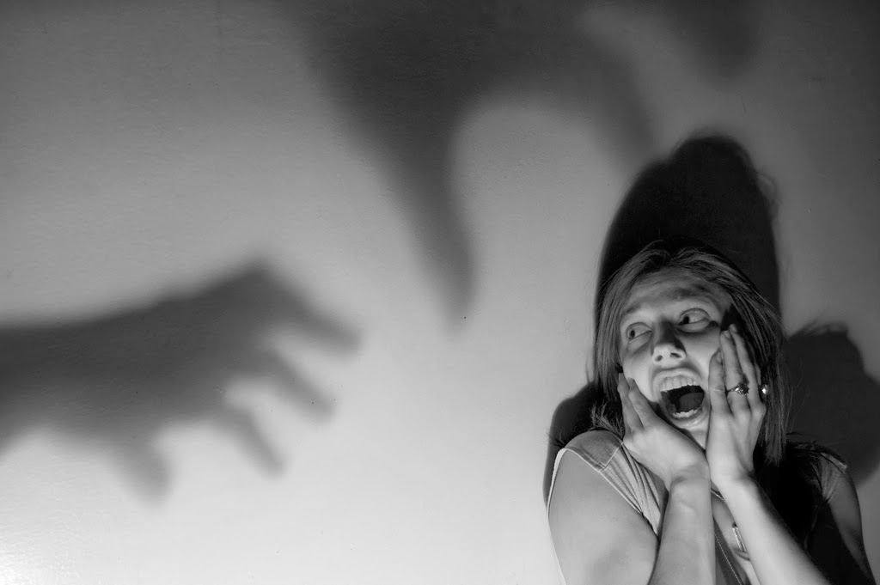
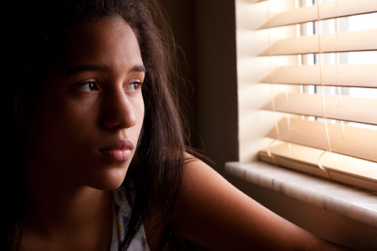
BODY LANGUAGE

Slide 44
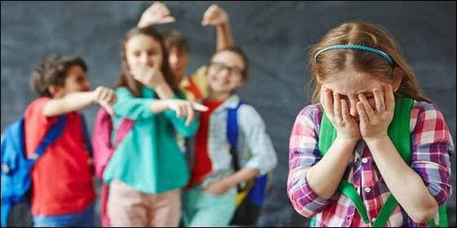
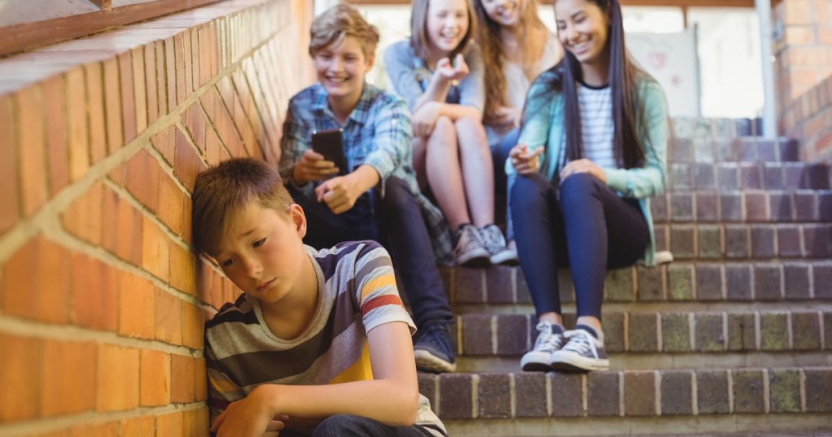
Bullying at school

Slide 45
What is bullying?
It is regular, long-term exposure of a student to hostile actions by other students, the purpose of which is to cause him/her pain in the psychological sense (humiliation, distress and a sense of rejection)

Slide 46
3 FEATURES OF BULLYING
1. Intentionality
Action intended to cause harm
Not always present at the early stage
2. Repetition
Refers to “smaller” acts committed over a longer period of time
in the case of relational violence, it relies on persistence
3. Imbalance of power
the victim becomes helpless and stops defending himself/herself
it may be due to physical superiority however it often results from other factors

Slide 47
TYPES OF BULLYING
Physical:
hitting, spitting, pulling, pushing
destruction or theft of another student’s belongings such as clothes, notebooks, phone.
Verbal:
Calling names, making fun of, insulting or vulgar remarks
Gossiping about the person
Cyber violence:
Sending out insulting texts by smart phone or internet
Sending out compromising photos of the victim
Attacks on online forums
Relational
Exclusion from common activities
Not communicating/ ignoring the victim
Manipulating others so that they alienate the victim

Slide 48
WHY DO SOME CHILDREN HURT THEIR FRIENDS?
They feel unhappy and take out their sadness, anger and grief on others
They experience domestic violence and take it out on the weaker ones
They have a low level of empathy
They have low self-esteem and go out of their way to keep others from noticing it by demonstrating "strength"

Slide 49
Consequences of bullying on a persecuted and excluded person
What is going on inside the PERSON experiencing this?
What does he/she
feel?
What does he/she
think about him/herself?
To zdjęcie, autor: Nieznany autor, licencja: CC BY-NC

Slide 50
The effects of bullying
social anxiety
depression
suicidal thoughts – there is a term called bully-cide (suicide resulting from bulling)
lower self-esteem
psychosomatic disorders such as insomnia, bedwetting and inhibited appetite

Slide 51
CYBER VIOLENCE
• posting humiliating videos or photos online
• publishing ridiculing, vulgar comments and posts
• impersonating other people
• exclusion from online groups

Slide 52
The key role of WITNESSES of violence
“The world is a dangerous place, not because of those who do evil, but because of those who look on and do nothing.”
Albert Einstein

Slide 53
REMEMBER!
ONLY YOU CAN STOP THE VIOLENCE
REPORTING THIS TO ADULTS IS NOT SNITCHING BUT CARE FOR YOURSELF AND OTHERS' SAFETY AND WELL-BEING
ALWAYS REACT WHEN YOU SEE HOW SOMEONE HURTING ANOTHER HPERSON- LACK OF REACTION MAKES YOU A SUPPORTER!
YOUR OBJECTION - REACTION IS COURAGE, EMPATHY AND IT STOPS VIOLENCE!

Slide 54
CREATING A CLASS CONTRACT

Slide 55
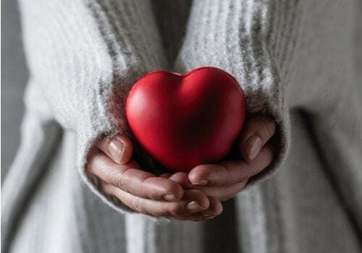
THE AMBASSADOR OF EMPATHY
YOU CAN TURN TO THIS PERSON IF YOU FEEL THAT A CLASSMATE IS HURTING YOU VERBALLY OR PHYSICALLY
Girl:……………………..
Boy:……………………..
He/She will talk to this person, reminding him/her about our workshop and if it does not help, he will turn to the class teacher

Slide 56
I HAVE A CHALLENGE
I KNOW that in almost every school there are people who have experienced such unpleasantness from colleagues
BEFORE YOU SAY SOMETHING TO SOMEONE, PAUSE/STOP AND ASK YOURSELF 2 QUESTIONS:
WILL THIS PERSON FEEL BETTER if I say this, if I do what I want to do?
WOULD I WANT someone to say that about me, to show me such a picture, to repeat such a rumor about me?

Slide 57
REMEMBER!
IT'S NOT OK WHEN YOU HUMILIATE AND MAKE OTHER PEOPLE JUST BECAUSE THEY DO / LOOK / FEEL DIFFERENTLY THAN YOU!
NO ONE IS LESS IMPORTANT THAN YOU!
AND YOU ARE NOT MORE IMPORTANT THAN OTHERS!
I am OK – You are OK !

